Slide 1
ML總整理

Slide 2
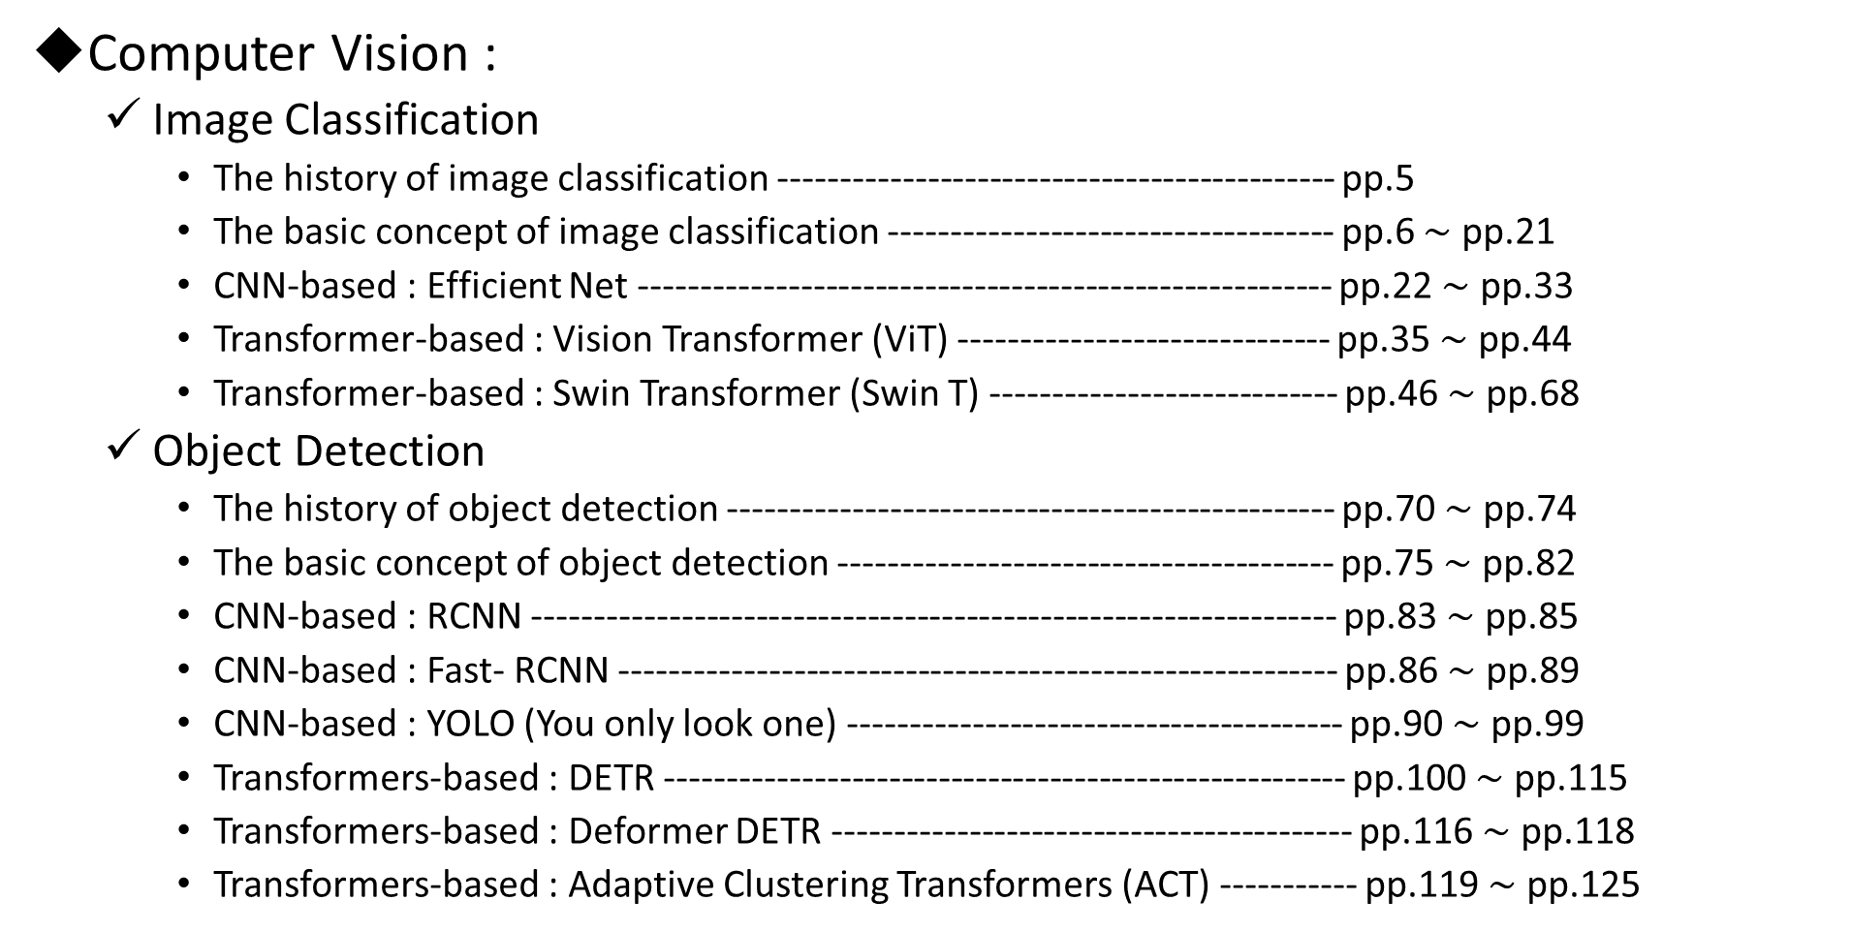
Table of Content
Computer Vision :
  Image Classification
    The history of image classification --------------------------------------------- pp.5
    The basic concept of image classification ------------------------------------ pp.6 $\sim$ pp.21
    CNN-based : Efficient Net -------------------------------------------------------- pp.22 $\sim$ pp.33
    Transformer-based : Vision Transformer (ViT) ------------------------------ pp.35 $\sim$ pp.44
    Transformer-based : Swin Transformer (Swin T) ---------------------------- pp.46 $\sim$ pp.68
  Object Detection
    The history of object detection ------------------------------------------------- pp.70 $\sim$ pp.74
    The basic concept of object detection ---------------------------------------- pp.75 $\sim$ pp.82
    CNN-based : RCNN ----------------------------------------------------------------- pp.83 $\sim$ pp.85
    CNN-based : Fast- RCNN ---------------------------------------------------------- pp.86 $\sim$ pp.89
    CNN-based : YOLO (You only look one) ---------------------------------------- pp.90 $\sim$ pp.99
    Transformers-based : DETR ------------------------------------------------------- pp.100 $\sim$ pp.115
    Transformers-based : Deformer DETR ------------------------------------------ pp.116 $\sim$ pp.118
    Transformers-based : Adaptive Clustering Transformers (ACT) ----------- pp.119 $\sim$ pp.125

Slide 3
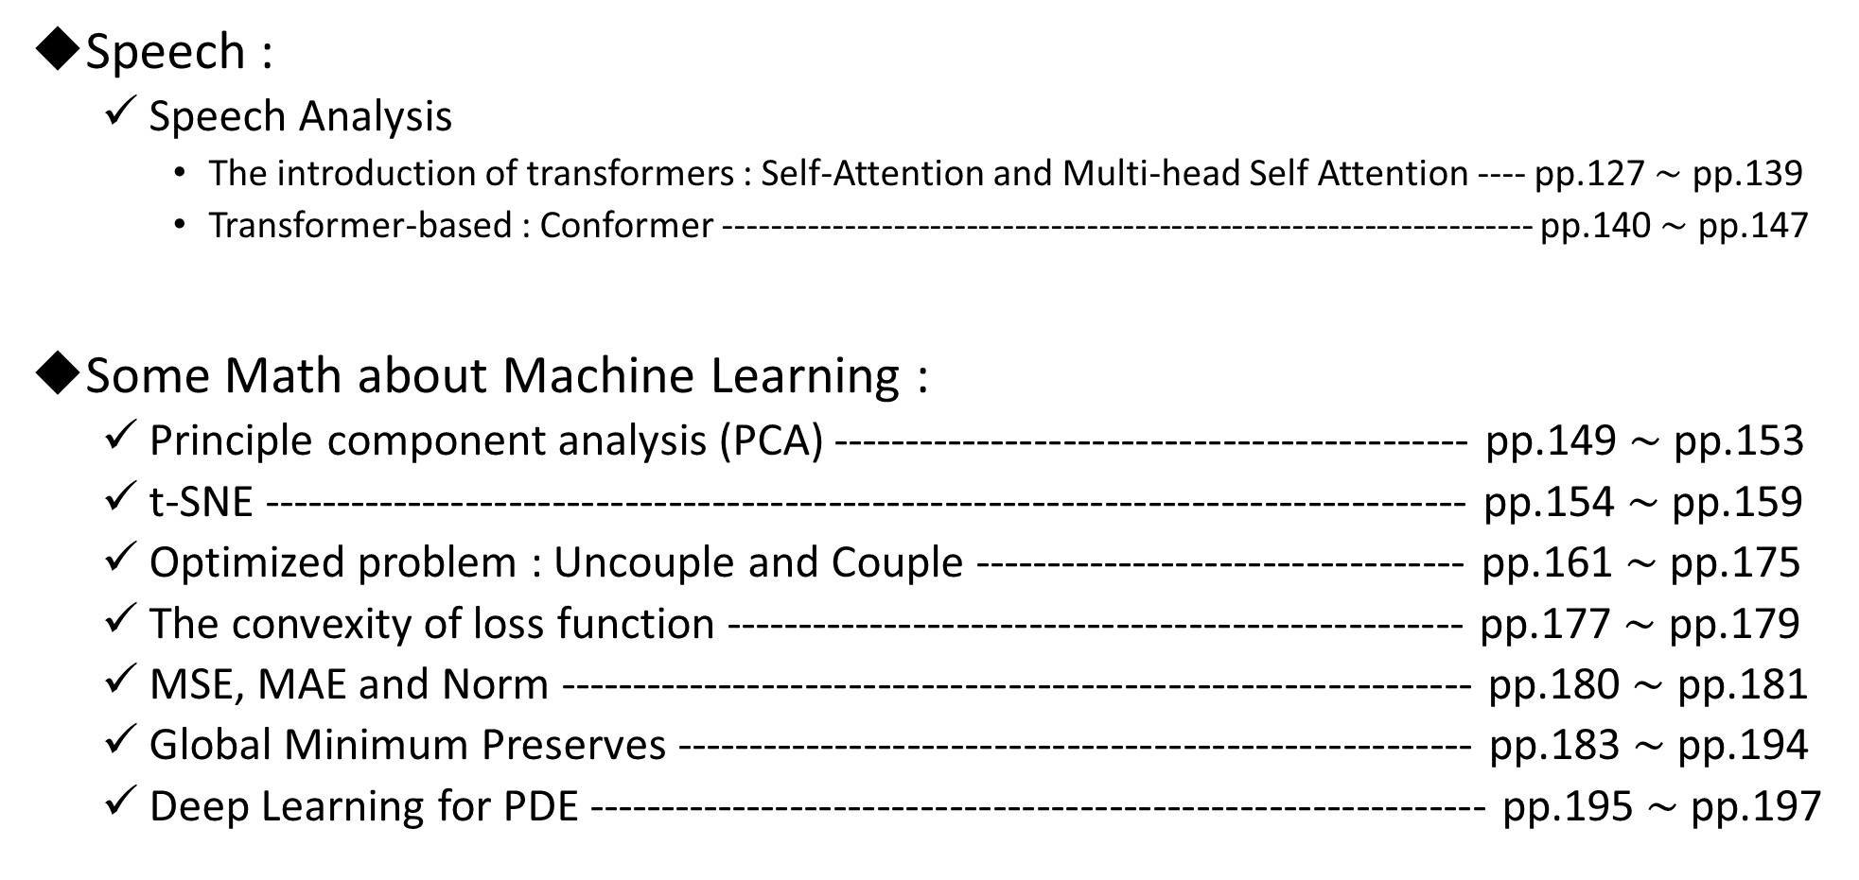
Table of Content
Speech :
  Speech Analysis
    The introduction of transformers : Self-Attention and Multi-head Self Attention ---- pp.127 $\sim$ pp.139
    Transformer-based : Conformer ------------------------------------------------------------------- pp.140 $\sim$ pp.147
Some Math about Machine Learning :
  Principle component analysis (PCA) -------------------------------------------- pp.149 $\sim$ pp.153
  t-SNE ----------------------------------------------------------------------------------- pp.154 $\sim$ pp.159
  Optimized problem : Uncouple and Couple ---------------------------------- pp.161 $\sim$ pp.175
  The convexity of loss function --------------------------------------------------- pp.177 $\sim$ pp.179
  MSE, MAE and Norm --------------------------------------------------------------- pp.180 $\sim$ pp.181
  Global Minimum Preserves ------------------------------------------------------- pp.183 $\sim$ pp.194
  Deep Learning for PDE -------------------------------------------------------------- pp.195 $\sim$ pp.197

Slide 4
Task :
Image Classification
Something math about image classification

Slide 5
Image Classification
Useful pytorch link : https://pytorch.org/vision/stable/models.html
History:
Network
Time
LeNet
1998
AlexNet
2012~2013
Image Classification
VGGNet, GoogleNet
2014~2015
Inceptron, DenseNet, ResNet
2016~2018
Efficient-Net
2019~2020
Vision-Transformer (ViT)
& Swin Transformer
2021~2022

Slide 6
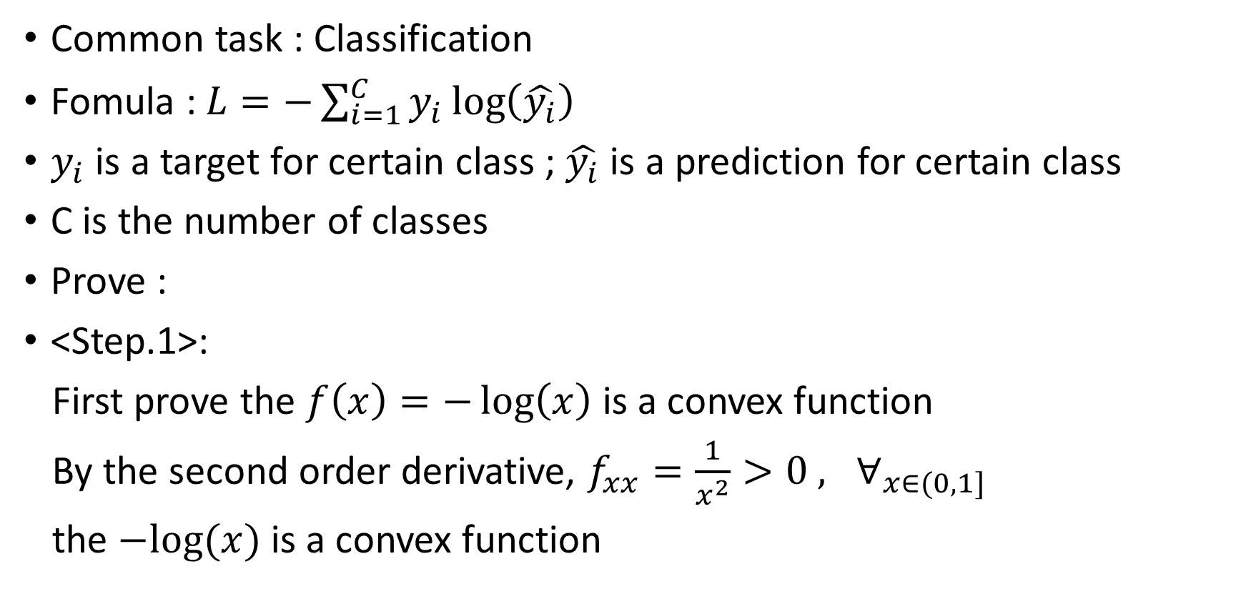
Loss function : Cross Entropy
Common task : Classification
Fomula : $L=−\sum_{i=1}^{C}{y_{i}\log\left(\hat{y_{i}}\right)}$
$y_{i}$ is a target for certain class ; $\hat{y_{i}}$ is a prediction for certain class
C is the number of classes
Prove :
<Step.1>:
First prove the $f\left(x\right)=−\log\left(x\right)$ is a convex function
By the second order derivative, $f_{xx}=\frac{1}{x^{2}}>0 , ∀_{x∈(0,1]}$
the $−log⁡(x)$ is a convex function

Slide 7
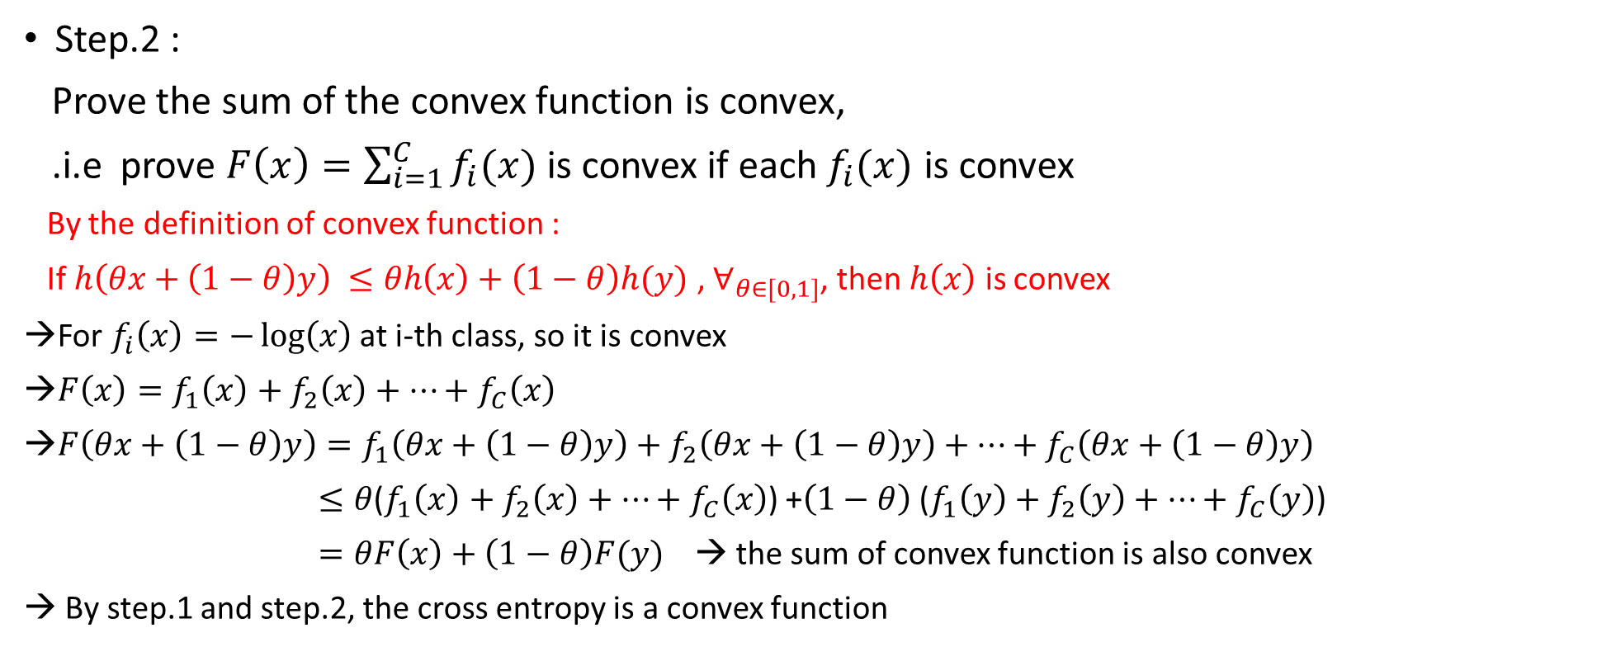
Loss function : Cross Entropy
Step.2 :
Prove the sum of the convex function is convex,
.i.e prove $F\left(x\right)=\sum_{i=1}^{C}{f_{i}(x)}$ is convex if each $f_{i}(x)$ is convex
By the definition of convex function :
If $h\left(θx+\left(1−θ\right)y\right) ≤θh\left(x\right)+\left(1−θ\right)h(y)$ , $∀_{θ∈[0,1]}$, then $h\left(x\right)$ is convex
For $f_{i}\left(x\right)=−\log\left(x\right)$ at i-th class, so it is convex
$F\left(x\right)=f_{1}\left(x\right)+f_{2}\left(x\right)+…+f_{C}\left(x\right)$
$F\left(θx+\left(1−θ\right)y\right)=f_{1}\left(θx+\left(1−θ\right)y\right)+f_{2}\left(θx+\left(1−θ\right)y\right)+…+f_{C}\left(θx+\left(1−θ\right)y\right)$
$≤θ$($f_{1}\left(x\right)+f_{2}\left(x\right)+…+f_{C}\left(x\right)$) +$\left(1−θ\right)$ ($f_{1}\left(y\right)+f_{2}\left(y\right)+…+f_{C}\left(y\right)$)
$=θF\left(x\right)+\left(1−θ\right)F(y)$ → the sum of convex function is also convex
→ By step.1 and step.2, the cross entropy is a convex function

Slide 8
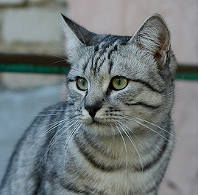



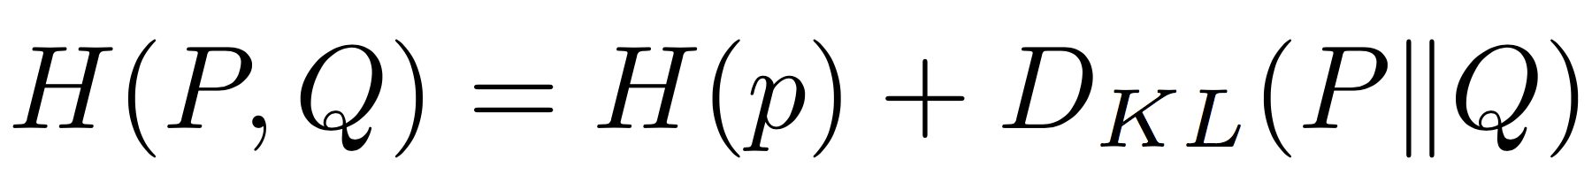
Image Classification concept
SoftMax : Enlarge the probability difference for the predicted output of model
Input Image
Want to interpret raw classifier scores as probabilities
X : input feature ; Y: label
Softmax function
Probabilities must be >= 0
Probabilities must sum to 1
3.2
24.5
0.13
Compare
1.00
cat
exp
normalize
car
Model
5.1
164.0
0.87
Cross Entropy
0.00
-1.7
0.18
0.00
0.00
frog
Unnormalized log-probabilities / logits
unnormalized probabilities
probabilities
Correct
probs
KL-divergence
<ref> : https://zh.wikipedia.org/zh-tw/%E7%9B%B8%E5%AF%B9%E7%86%B5

Slide 9
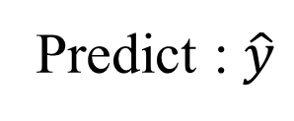
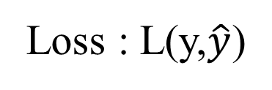
Back-propagation
Forward propagation and Back-propagation:
Input : x
Forward propagation : Predict the results
Predict : $\hat{y}$
Final loss
Loss : L(y,$\hat{y}$)
loss.backward()
Backward propagation : Using for loss function.
Calculate the difference of predicted results and real label

Slide 10
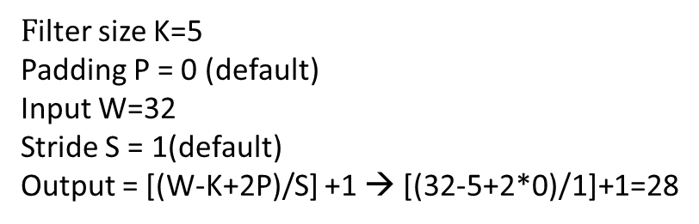
CNN Model
32
28
26
….
Conv
ReLU
Conv
ReLU
Conv
ReLU
W₁: 6x3x5x5
b₁: 6
W₂: 10x6x3x3
b₂: 10
W₃: 12x10x3x3
b₃: 12
32
28
26
3
6
10
Input:
N x 3 x 32 x 32
First hidden layer:
N x 6 x 28 x 28
Second hidden layer:
N x 10 x 26 x 26
In general:
Input: W
Filter: K
Padding: P
Stride: S
Output: (W – K + 2P) / S + 1
$F$ilter size K=5
Padding P = 0 (default)
Input W=32
Stride S = 1(default)
Output = [(W-K+2P)/S] +1 → [(32-5+2*0)/1]+1=28

Slide 11
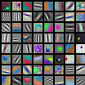
CNN Model
32
28
First-layer conv filters: local image templates
(Often learns oriented edges, opposing colors)
Conv
ReLU
W₁: 6x3x5x5
b₁: 6
32
28
3
6
Input:
N x 3 x 32 x 32
First hidden layer:
N x 6 x 28 x 28
AlexNet: 64 filters, each 3x11x11

Slide 12
CNN Model
Input volume: 3 x 32 x 32
10 5x5 filters with stride 1, pad 2
Output volume size:
(32+2*2-5)/1+1 = 32 spatially, so
10 x 32 x 32
In general:
Input: W
Filter: K
Padding: P
Stride: S
Output: (W – K + 2P) / S + 1

Slide 13
CNN Model
Input volume: 3 x 32 x 32
10 5x5 filters with stride 1, pad 2
Output volume size: 10 x 32 x 32
Number of learnable parameters: 760
Parameters per filter: 3*5*5 + 1 (for bias) = 76
10 filters, so total is 10 * 76 = 760

Slide 14
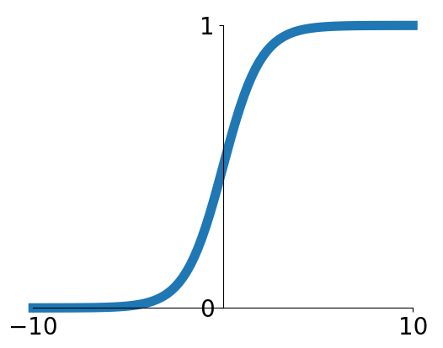
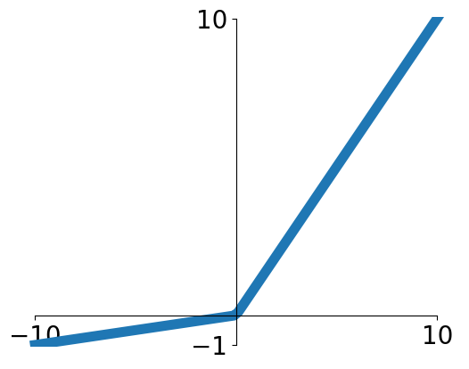


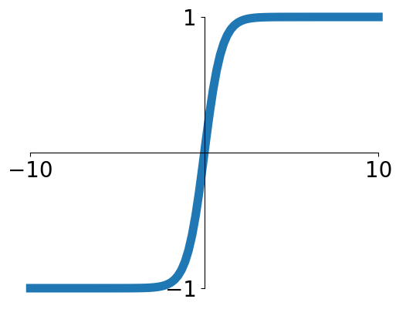


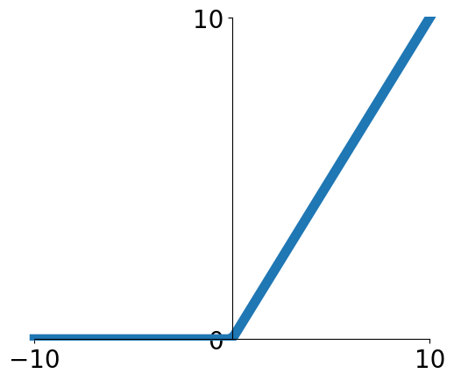
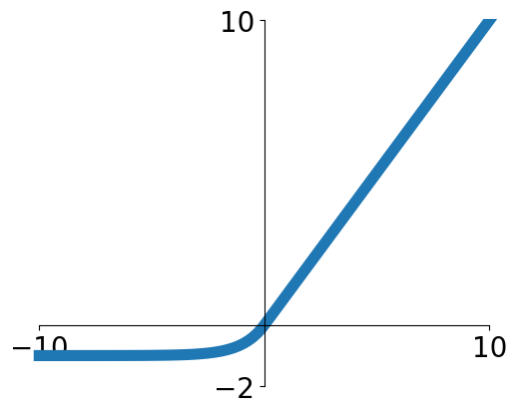

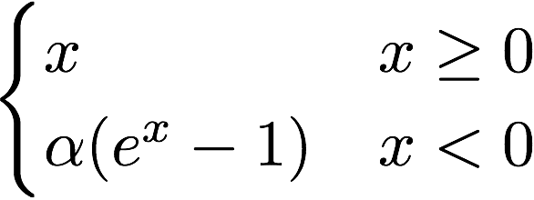
Activation Functions
ReLU is a good default choice for most problems
Sigmoid
Leaky ReLU
tanh
Maxout
ReLU
ELU
ELU: Exponential Linear Unit

Slide 15
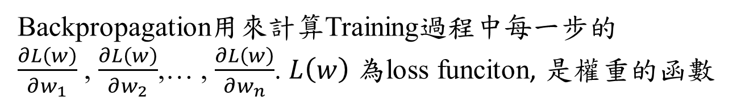

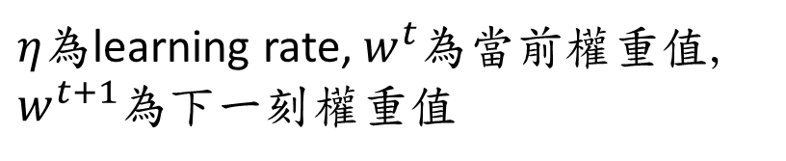
Backpropagation
Goal : Calculating the gradient of loss function
$w_{1}^{t+1}=w_{1}^{t}−η\frac{∂L\left(w\right)}{∂w_{1}}$
$w_{2}^{t+1}=w_{2}^{t}−η\frac{∂L\left(w\right)}{∂w_{2}}$
$⋮$
$w_{n}^{t+1}=w_{n}^{t}−η\frac{∂L\left(w\right)}{∂w_{n}}$
Backpropagation用來計算Training過程中每一步的
$\frac{∂L\left(w\right)}{∂w_{1}}$ , $\frac{∂L\left(w\right)}{∂w_{2}}$,… , $\frac{∂L\left(w\right)}{∂w_{n}}$. $L\left(w\right)$ 為loss funciton, 是權重的函數
$η$為learning rate, $w^{t}$為當前權重值,
$w^{t+1}$為下一刻權重值

Slide 16
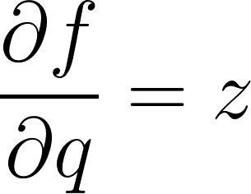
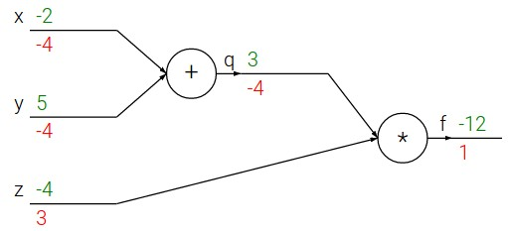
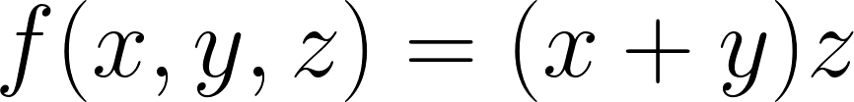
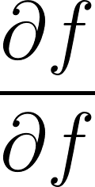


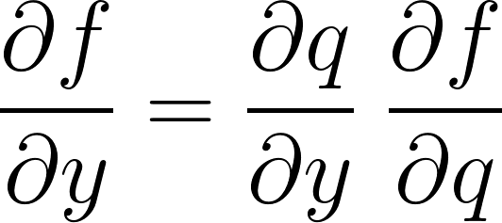
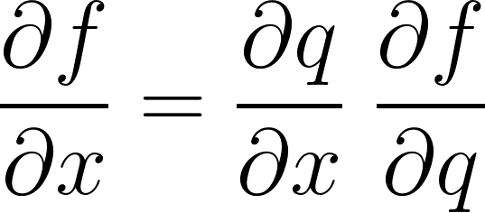
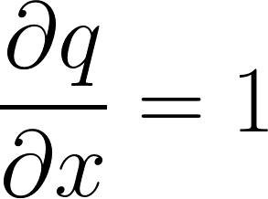
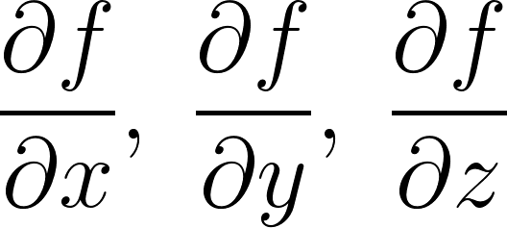
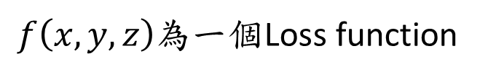

Back-propagation
$$\frac{∂f}{∂z}=q=x+y$$
Backpropagation:
e.g. x = -2, y = 5, z = -4
1. Forward pass: Compute outputs
Chain Rule
Chain Rule
2. Backward pass: Compute derivatives
Want:
Downstream
Gradient
Local
Gradient
Upstream
Gradient
$f\left(x,y,z\right)$為一個Loss function

Slide 17

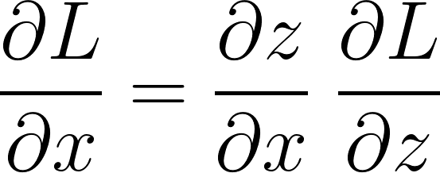
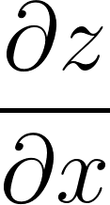
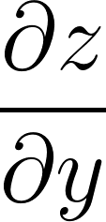
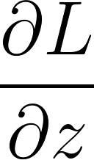
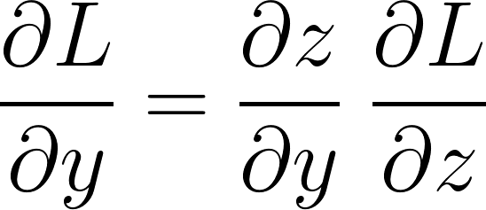
Back-propagation
Overview:
f
Local gradients
Upstream gradient

Slide 18
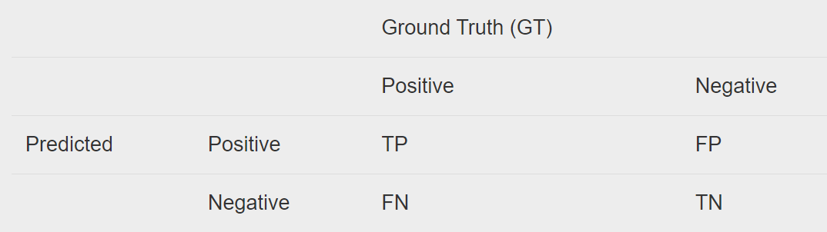
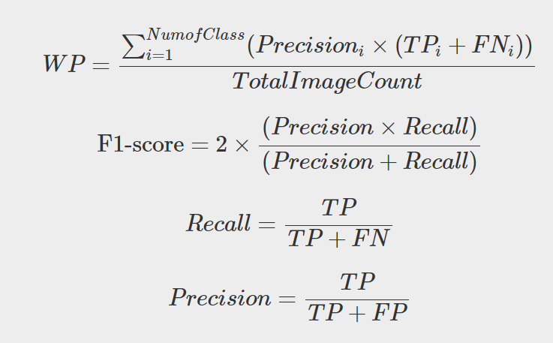

Common performance index for binary class
$0≤f1−score≤1$
$f1−score :$越接近1越好,代表Recall = Precision
TP: True positive : 預測為正,實際上也為正的數量
TN: True negative : 預測為負,實際上也為負的數量
FP: False positive : 預測為正,但實際上為負的數量
FN: False negative : 預測為負,但實際上為正的數量
WP : Weight Precision

Slide 19
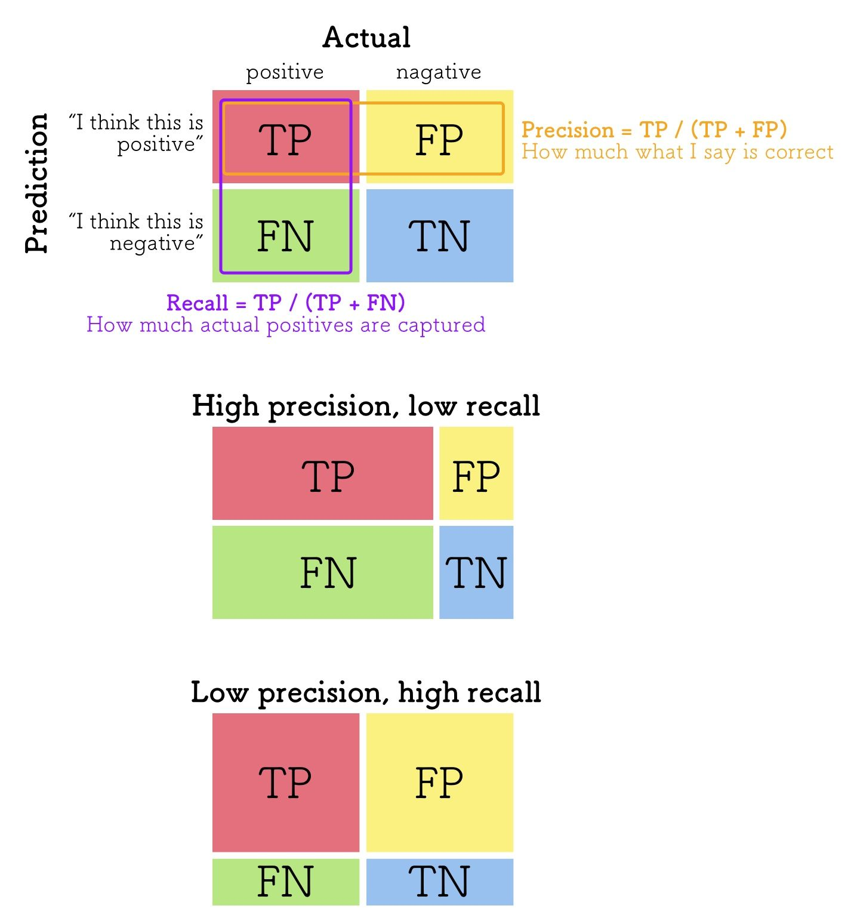

Precision and Recall
Precision and Recall
Performance要好當然Precision和Recall都要很好, 但兩個通常都是Trade-off.
因此要使f1-score最大(f1-score=1)就是兩者相等
F1-score = $2×\frac{Precision×Recall}{Precision+recall}$

Slide 20
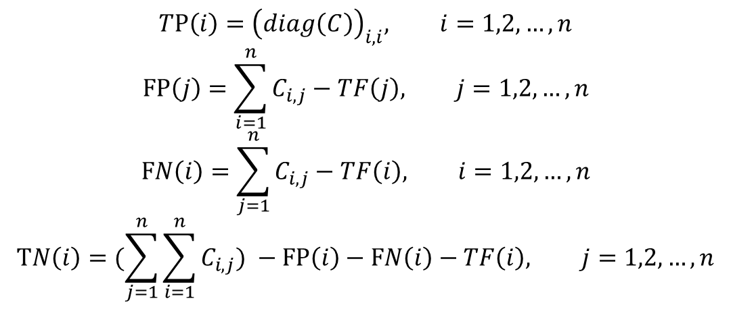
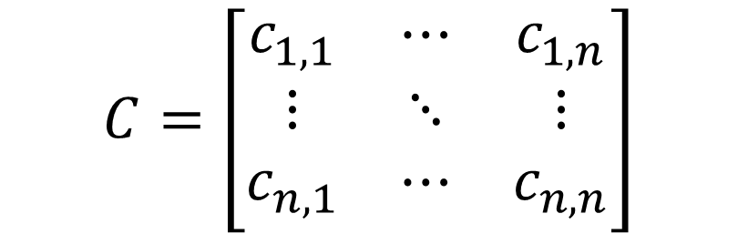
Common performance index for multiclass
Confusion Matrix C:
Predicted
$$C=\left[\begin{matrix}c_{1,1} & ⋯ & c_{1,n} \\ ⋮ & ⋱ & ⋮ \\ c_{n,1} & ⋯ & c_{n,n}\end{matrix}\right]$$
Ground
Truth
Total class = n
$$TP\left(i\right)={\left(diag\left(C\right)\right)}_{i,i}, i=1,2,…,n$$
$$FP\left(j\right)=\sum_{i=1}^{n}{C_{i,j}}−TF\left(j\right), j=1,2,…,n$$
$$FN\left(i\right)=\sum_{j=1}^{n}{C_{i,j}}−TF\left(i\right), i=1,2,…,n$$
$$TN\left(i\right)=(\sum_{j=1}^{n}{\sum_{i=1}^{n}{C_{i,j}}) }−FP\left(i\right)−FN\left(i\right)−TF\left(i\right), j=1,2,…,n$$

Slide 21
Common performance index for multiclass
For class 1:
TF = A1;
FP = A4+A7
FN = A2+A3
TN = A5+A6+A8+A9
Example : Total class = 3
Predicted
Class_1
Class_2
Class_3
Class_1
A1
A2
A3
For class 2:
TF = A5;
FP = A2+A8
FN = A4+A6
TN = A1+A3+A7+A9
Ground
Truth
Class_2
A4
A5
A6
For class 3:
TF = A9;
FP = A3+A6
FN = A7+A8
TN = A1+A2+A4+A6
Class_3
A7
A8
A9

Slide 22
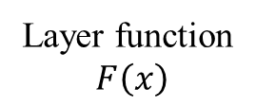
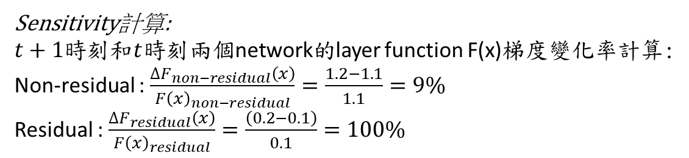

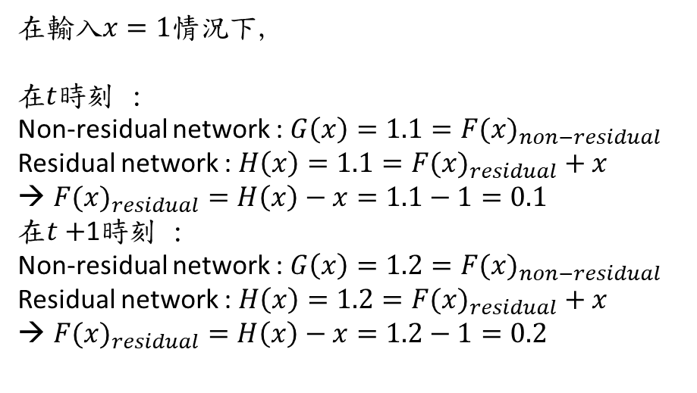
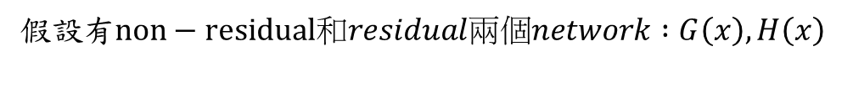
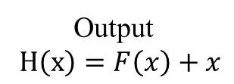
CNN : Resnet Unit architecture
Input feature $x$
Residual network layer H(x)
如果F(x)= 0代表identity mapping(恆等映射),即H(x)=x
Weight Layer
假設有$non−residual和residual兩個network :G\left(x\right), H\left(x\right)$
Layer function
$F\left(x\right)$
ReLU
在輸入$x=1$情況下,
在$t$時刻 :
Non-residual network : $G\left(x\right)=1.1={F(x)}_{non−residual}$
Residual network : $H\left(x\right)=1.1={F(x)}_{residual}+x$
${F(x)}_{residual}=H\left(x\right)−x=1.1−1=0.1$
在$t+$1時刻 :
Non-residual network : $G\left(x\right)=1.2={F(x)}_{non−residual}$
Residual network : $H\left(x\right)=1.2={F(x)}_{residual}+x$
${F(x)}_{residual}=H\left(x\right)−x=1.2−1=0.2$
Weight Layer
Output
$H\left(x\right)=F\left(x\right)+x$
Sensitivity計算:
$t+1$時刻和$t$時刻兩個network的layer function F(x)梯度變化率計算:
Non-residual : $\frac{∆F_{non−residual}\left(x\right)}{{F\left(x\right)}_{non−residual}}=\frac{1.2−1.1}{1.1}=9\%$
Residual : $\frac{∆F_{residual}\left(x\right)}{{F\left(x\right)}_{residual}}=\frac{\left(0.2−0.1\right)}{0.1}=100\%$
也就是說residual network梯度變化較
non-residual network敏感(Sensitive),因此隨著
network越深或者越大,可避免掉
梯度消失(Gradient vanishing)的問題,
梯度消失就是梯度趨近於0的意思

Slide 23
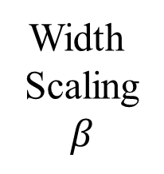

CNN : Efficient Net Model
channels
Wider : $β×\text{channels}$
Width
Scaling
$$β$$
Layer i
Resolution
HxW

Slide 24
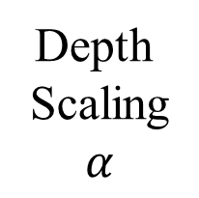
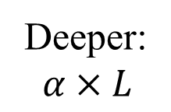

CNN : Efficient Net Model
channels
Deeper:
$$α×L$$
Depth
Scaling
$$α$$
$$L$$
Layer i
Resolution
HxW

Slide 25
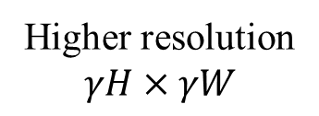
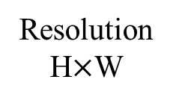
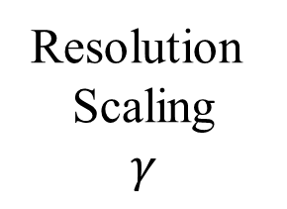
CNN : Efficient Net Model
channels
channels
Resolution
Scaling
$$γ$$
Layer i
Higher resolution
$$γH×γW$$
Resolution
H$×$W

Slide 26






CNN : Efficient Net Model
Paper : https://arxiv.org/abs/1905.11946
Wider : $β×\text{channels}$
$$d=α^{φ}$$
$$w=β^{φ}$$
$$r=γ^{φ}$$
$$s.t. αβ^{2}γ^{2}≅2 , α≥1,β≥1,γ≥1$$
$φ$ is adaptive hyper-parameters
channels
Compound
Scaling
$α$, $β$, $γ$
Deeper:
$$α×L$$
$$L$$
Layer i
Higher resolution
$$γH×γW$$
Resolution
HxW

Slide 27
CNN : Efficient Net Model
單一縮放維度並不能增加精度, 比如:很深(deeper)網絡但卻很瘦(not wider), 精度都會達到飽和
因此Efficient net的精神就是Compound scaling, 同時考慮到depth, width, resolution, 在trainging過程中adaptive進行compound scaling
Depth : Depth越大,代表network越深, 但越深其精度有限
Width : Width越大,代表network使用的channels越多, 但其精度也有限
Resolution : Resolution越高,精度固然好, 但因為資源有限, 不可能
一次放進高resolution image,記憶體可能會爆掉

Slide 28

CNN : Efficient Net Model
Advantages :
Lower parameters
Performance better than any classification network as far
Saving resource

Slide 29

CNN : Efficient Net Model
Advantages :
Lower parameters
Performance better than any
classification network as far
3. Saving resource

Slide 30







Data augmentation
Gaussian Blur
Affine transformation
Original image
Rotation
Color transformation
Flip
Useful link : https://pytorch.org/vision/stable/transforms.html
Crop

Slide 31
Flow chart of image classification
Preprocessing : data augmentation, e.g: color transform, rotation, flip, crop…
Model : model architecture, optimizer, loss function
Postprocessing : ensemble learning, test-time augmentation…
Input
Output
Preprocessing
Model
Postprocessing
Transfer learning
You can apply transfer learning or not.
If the number of dataset is fewer or the model is larger,
maybe you can use transfer learning

Slide 32









Ensemble learning
Average : $λ_{1}$=$λ_{2}$=$λ_{3}$
Model $A(x)$
$$λ_{1}$$
Input $x$
Model $B(x)$
$$λ_{1}A(x)+λ_{2}B(x)+λ_{3}C(x)$$
$$λ_{2}$$
Model $C(x)$
$$λ_{3}$$

Slide 33










Test-time augmentation
$$\left(1−α\right)/3$$
Crop
$$1−α$$
$$\left(1−α\right)/3$$
Train
Augmentation
Color
transformation
Test image
$$\left(1−α\right)/3$$
Predicted
Flip
$$α$$
Test
Augmentation
Average :$α$=0.5
If we want to boost performance, we can make $α$ higher because test image is dominant domain.

Slide 34
Task :
Image Classification-Transformers
Vision- Transformers (ViT)
Paper : https://arxiv.org/abs/2010.11929
2021

Slide 35

CNN和Attention機制
CNN和Attention機制在影像分類領域中交互作用關係 :
Adv:局部(Local)捕捉能力好
Disadv: 難以捕捉影像中關鍵
物信息
Adv: 全局(Global)捕捉能力好
Disadv:計算量很大

Slide 36

Vision-Transformer (ViT)
Useful link:
https://colab.research.google.com/github/hirotomusiker/schwert_colab_data_storage/blob/master/notebook/Vision_Transformer_Tutorial.ipynb

Slide 37


Patch-Position Embeddings
14
14
Class
token
Position
Embedding
1x768
197x768
Conv2d
768 channels
, 16x16 patch filter
14x14x768
Flatten
Concat
Transformer
Encoder
196x768
197x768
Embedding
patch
將影像切成
256塊patch
(256=16x16)
原始輸入影像大小
(HxWxC):
224x224x3
最終patch塊數量
N = (H/P1)x(W/P2)
=14x14
每塊patch大小為(P1xP2)
(16x16)
每塊patch的維度
(P1xP2xC)=16x16x3=768

Slide 38


Position Embedding
藉由Position embedding方式可以知道Input patch之間的相似性
Cosine similarity :

Slide 39


















Transformers-Multi-head self attention
三個Initial weight matrix:
$W^{q},W^{k},W^{v}$ : 768來自於前面Embedding patch size 197x768
$W^{q}$ is 768$×d$, $W^{k}$ is 768 $×d$, $W^{v}$ is 768 $×d$’ ($W^{v}$最後維度$d$’不一定要跟$W^{q}$, $W^{k}$, 但$W^{q}$, $W^{k}$兩個維度要一樣)
d
d
197
197
$$QK^{T}$$
$$×$$
197
SoftMax
0.1
0.7
0.4
Q
0.2
0.5
197
$$W^{q}$$
197
0.3
768
0.5
0.9
0.8
768
197
$$SoftMax\left(QK^{T}\right)$$
d
d
$$SoftMax\left(QK^{T}\right)∙V$$
$$×$$
197
Transpose
$$W^{k}$$
K
$${\text{K} }^{T}$$
d
768
Embedding
patch
197
197
d’
d’
d’
$$×$$
$$V$$
Attention matrix
feature
768
$$W^{v}$$
V
197
Formula : $Attention\left(Q,K,V\right)=SoftMax\left(\frac{QK^{T}}{\sqrt{d}}\right)V$

Slide 40

Transformers-Multi-head self attention
構建出很多Attention matrix (內積完的結果)當作feature map, 尋找與Class相關性最大的feature map

Slide 41

Transformers-Multi-head self attention
Attention 機制會關注於全局影像中裡最重要的信息, 如以下圖片 :

Slide 42

Overview of Vision Transformers (ViT)
1. Split Image into Patches
The input image is split into 14 x 14 vectors with dimension of 768 by Conv2d (k=16x16) with stride=(16, 16).
2. Add Position Embeddings
Learnable position embedding vectors are added to the patch embedding vectors and fed to the transformer encoder.
3. Transformer Encoder
The embedding vectors are encoded by the transformer encoder. The dimension of input and output vectors are the same.
4. MLP (Classification) Head
The 0th output from the encoder is fed to the MLP head for classification to output the final classification results.

Slide 43






Overview of Transformer encoder
197
Num_class
= 1000
Embedding
Patch
Classification
argmax
$$p_{1}$$
$$p_{2}$$
$$⋯⋯$$
$$p_{1000}$$
Num_class = 1000
Choose peak label
(相關性最大)
Multi-head self attention
N (=197) embedded vectors are fed to the L (=12) series encoders.
The vectors are divided into query, key and value after expanded by an fc layer.
q, k and v are further divided into H (=12) and fed to the parallel attention heads.
Outputs from attention heads are concatenated to form the vectors whose shape is the same as the encoder input.
The vectors go through an fc, a layer norm and an MLP block that has two fc layers.

Slide 44


Performance of ViT
Vision Transformers (ViT)在數據多的時候效果顯著, 代表更容易抓住全局影像中的重要信息, 缺點是計算複雜度可能很高, 比如影像一張就是NxN大小,要計算它的Attention matrix其計算量會非常高, 因此優化她複雜度是未來關鍵之一

Slide 45
Task :
Image Classification-Transformers
Swin- Transformers
Paper : https://openaccess.thecvf.com/content/ICCV2021/html/Liu_Swin_Transformer_Hierarchical_Vision_Transformer_Using_Shifted_Windows_ICCV_2021_paper.html2021

Slide 46

Architecture of Swin Transformer
Architecture : 相比Vision Transformer新增兩個Block (下圖紅色圈圈)
W-MSA
SW-MSA

Slide 47
Swin-T優於ViT原因
Shifted-Window Transformer(Swin-T):
增加兩個新運算Block :
W-MSA (Window-Multi-Self Attention): 增加Local資訊
SW-MSA (Shifted-Window-Multi-Self-Attention): 增加Patch間交流資訊和交叉
相關性(Cross correlation)
將Patch做random down-sampling, 減少Self-Attention計算量
Vision Transformer (ViT):
相比Swin-T只有一個特定Block : MSA (Multi-Self-Attention)
: 只能擁有Global資訊
因本身是固定Patch size, 其Self-Attention計算量很可觀

Slide 48


Patch with down-sampling size
Swin (Shifted Window) Transformer:
先來探討Swin Transformer和Vision Transformer有何不同 ?
Vision transformer : 使用的patch size一直維持16倍downsampling, 比較不助於分割任務
Swin transformer: 使用的patch size分層downsampling 16倍, 8倍, 4倍, 有助於分割任務, 且有助於減少計算量

Slide 49

ViT和Swin-T在Transformer架構上不同
Vision Transformer (ViT) :
Multi-Self-Attention (MSA) Block
Self-Attention( )
Attention feature
map 1
2. 每個patch在分別丟進
Self-Attention機制中,
稱作Muiti-Self-Attention (MSA)
Self-Attention( )
Attention feature
map 2
Self-Attention( )
Attention feature
map 3
Patch
1. 將影像切成4塊
大小相同的Patch
Input
Image
Self-Attention( )
Attention feature
map 4
<Note>: Q, K, V是self-attention中得到的三個feature map相關矩陣
<Note>: Q, K, V怎麼來的請參考Vision Transformer章節的
Transformers-Multi-head self attention,也就是本ppt的第40頁投影片

Slide 50

Multi Self Attention (MSA)
Multi Self Attention (MSA) : ViT and Swin-T both have this mechanism
ViT直接把整個patch丟進self-attention內部得到global attention map
Swin-T除了有把整塊patch丟進去self-attention外得到global attention map資訊外, 還會對patch再進行分割再分別丟進self-attention裡得到更local資訊
Self-
Attention()
Q, K, V
<Note>: Q, K, V是self-attention中得到的三個feature map相關矩陣
Attention feature map
for this patch
<Note>: Q, K, V怎麼來的請參考Vision Transformer章節的
Transformers-Multi-head self attention,也就是本ppt的第40頁投影片

Slide 51

Multi Self Attention (MSA)

Slide 52










ViT和Swin-T在Transformer架構上不同
3. 得到不同downsampling
下的patch的Attention map,
稱作W-MSA
SwinTransformer (Swin-T) :
Window-Multi-Self-Attention
(W-MSA) Block
2. 將每個patch在分別
做不同倍率downsampling
做1塊
Self-Attention
1x
Attention feature
map 1
做4塊
Self-Attention
$$⋰$$
2x
$$⋰$$
共4塊
Attention
Feature map
$$⋰$$
做16塊
Self-Attention
$$⋰$$
4x
$$⋰$$
共16塊
Attention
Feature map
Patch
$$⋰$$
Input
Image
1. 將影像切成4塊
大小相同的Patch
做64塊
Self-Attention
$$⋰$$
8x
$$⋰$$
共64塊
Attention
Feature map
$$⋰$$

Slide 53













W-MSA
Window-Multi-Self-Attention (W-MSA) : Only Swin-T has this mechanism
4x4
Attention feature map A
Self-Attention( )
$Q_{A}$, $K_{A}$, $V_{A}$
4x4
4x4
4x4
Self-Attention( )
Attention feature map B
A
B
$Q_{B}$, $K_{B}$, $V_{B}$
4x4
Attention feature map C
4x4
4x4
Self-Attention( )
C
D
$Q_{C}$, $K_{C}$, $V_{C}$
4x4
Attention feature map D
Partition Patch
Self-Attention( )
$Q_{D}$, $K_{D}$, $V_{D}$
<Note>: Q, K, V是self-attention中得到的三個feature map相關矩陣

Slide 54









ViT和Swin-T在Transformer架構上不同
SwinTransformer (Swin-T) :
Shifted-Window-Multi-Self-Attention
(SW-MSA) Block
2. 將每個patch在分別
做不同倍率downsampling
3. 得到不同downsampling
下的patch的Attention map,
稱作W-MSA
做1塊
Self-Attention
1x
Attention feature
map 1
Input
Image
做4塊
Self-Attention
$$⋰$$
2x
$$⋰$$
共4塊
Attention
Feature map
4. Concat
$$⋰$$
5. LN, MLP
做16塊
Self-Attention
$$⋰$$
4x
$$⋰$$
共16塊
Attention
Feature map
$$⋰$$
Patch
SW-MSA
做64塊
Self-Attention
$$⋰$$
1. 將影像切成4塊
大小相同的Patch
8x
$$⋰$$
共64塊
Attention
Feature map
$$⋰$$

Slide 55


Shifted Window(Swin) Spirit
Shifted Window (Swin):
因為在Transformer block中, 對於patch size取樣不同size的patch, W-MSA
只會對單一模塊進行Self-attention, 所以Window之間是無法交換訊息的,
因此提出Shift window概念, 也因此有SW-MSA block.

Slide 56














Shifted Window(Swin) Spirit
從Layer l到Layer l+1 過程就是進入SW-MSA過程, 我們發現在SW-MSA中$B_{2}$ window橫跨前個Layer l的$A_{1}$ , $A_{2}$ window資訊
$B_{5}$ window橫跨$A_{1}$ , $A_{2}$ , $A_{3}$ , $A_{4}$ window資訊, 依此類推…
因此進到SW-MSA中, 各個Patch就會彼此分享前一個Layer資訊,這就是SW-MSA的目的
$$B_{1}$$
$$B_{2}$$
$$B_{3}$$
$$A_{1}$$
$$A_{2}$$
$$B_{4}$$
$$B_{5}$$
$$B_{6}$$
$$A_{3}$$
$$A_{4}$$
$$B_{7}$$
$$B_{8}$$
$$B_{9}$$
W-MSA
SW-MSA

Slide 57

Patch Merging Block
Block : Patch Merging
假設輸入Patch Merging的是一個4x4大小的單個channel feature map，Patch Merging會將每個2x2的相鄰pixels劃分為一個patch，然後將每個patch中相同位置（同一颜色）像素給拼在一起就得到了4個feature map。接著將這四個feature map在深度方向進行concat拼接，然後在通過一個LayerNorm層。最後通過一個Fully connected layer ，在feature map的深度方向做線性變化，將feature map的深度由C變成C/2。通過這個簡單的例子可以看出，通過Patch Merging層後，feature map的高和宽會減半，深度會翻倍。

Slide 58



Performance
Performance:
可以發現Swin-Transformer的運算量(#para)比Vision-Transformer運算量少
可以發現Swin-Transformer的Accuracy (acc)比Vision-Transformer高
可以發現Swin-Transformer的吞吐量(Throughput)比Vision-Transformer高

Slide 59





Swin Transformer計算量分析
Swin Transformer引進W-MSA block就是為了解決Vision Transformer
計算量高的問題
首先複習Self-Attention Mechanism Flowchart:
$$W^{Q}$$
Q
Formula :
$$Attention\left(Q,K,V\right)=SoftMax\left(\frac{QK^{T}}{\sqrt{d}}\right)V$$
Self-Attention
$$W^{K}$$
Patch size
$P^{h×w×c}$
K
Feature Map
h: height
w: width
c: channel
$$W^{V}$$
V

Slide 60























Swin Transformer計算量分析
MSA(Multi-Head Self Attention)計算量分析:
$$W_{Q}^{C×C}$$
$$PW_{Q}:hwC^{2}$$
$${QK}^{T}:{\left(hw\right)}^{2}C$$
$${\left(\frac{{QK}^{T}}{\sqrt{d} }\right)}^{hw×hw}$$
$$Q^{hw×C}$$
$$÷\sqrt{d}$$
$$W_{K}^{C×C}$$
$$SoftMax$$
$$PW_{K}:hwC^{2}$$
$${SoftMax \left(\frac{{QK}^{T}}{\sqrt{d} }\right)}^{hw×hw}$$
Patch size
$P^{hw×C}$
Transpose
$${K^{T}}^{C×hw}$$
$$K^{hw×C}$$
$$W_{V}^{C×C}$$
$SoftMax \left(\frac{{QK}^{T}}{\sqrt{d} }\right)V$: ${\left(hw\right)}^{2}C$
$$PW_{V}:hwC^{2}$$
$${\left(SoftMax \left(\frac{{QK}^{T}}{\sqrt{d} }\right)V\right)}^{hw×C}$$
$$V^{hw×C}$$
MSA Formula :
$$MSA\left(Q,K,V\right)=SoftMax\left(\frac{QK^{T}}{\sqrt{d}}\right)VW_{M}$$
總計算量 : $4hwC^{2}+2{\left(hw\right)}^{2}C$
$$SoftMax \left(\frac{{QK}^{T}}{\sqrt{d} }\right)VW_{M}:hwC^{2}$$
$${\left(SoftMax \left(\frac{{QK}^{T}}{\sqrt{d} }\right)VW_{M} \right)}^{hw×C}$$
$$W_{M}^{C×C}$$
$W_{M}$用來將單個Attention合成多個Attention
的矩陣運算，所以稱作Multi-Head Attention

Slide 61






















Swin Transformer計算量分析
WMSA(Window Multi-Head Self Attention)計算量分析:
藉由Window將Patch分割成好幾塊小Patch : 假設Window size為$M×M$
從第62頁圖分析來看，單一塊Patch做Multi-Head Self Attention (MSA)的總運算量為
$4hwC^{2}+2{\left(hw\right)}^{2}C$，這次將h和w換成Window size M, M ，故為$4{M^{2}C}^{2}+2M^{4}C$
總共有$\frac{h}{M}×\frac{w}{M}$塊分割的Patch
$$M$$
$$P_{1}$$
$$M$$
MSA
運算量$=4{M^{2}C}^{2}+2M^{4}C$
$$M$$
$$P_{2}$$
$$M$$
MSA
運算量$=4{M^{2}C}^{2}+2M^{4}C$
Patch size
$P^{hw×C}$
$$⋮$$
$$⋮$$
$$⋮$$
$$⋮$$
$$⋮$$
$$⋮$$
$$⋮$$
$$⋮$$
$$⋮$$
$$⋮$$
$$⋮$$
$$⋮$$
$$⋮$$
$$⋮$$
$$⋮$$
$$⋮$$
$$⋮$$
$$⋮$$
$$M$$
總運算量:
$\frac{h}{M}×\frac{w}{M}$ $×\left(4{M^{2}C}^{2}+2M^{4}C\right)$
$$=4hwC^{2}+2M^{2}hwC$$
$$P_{\frac{h}{M}×\frac{w}{M}}$$
$$M$$
MSA
運算量$=4{M^{2}C}^{2}+2M^{4}C$

Slide 62



Swin Transformer計算量分析
Paper:
https://openaccess.thecvf.com/content/ICCV2021/html/Liu_Swin_Transformer_Hierarchical_Vision_Transformer_Using_Shifted_Windows_ICCV_2021_paper.html2021
以下為本篇Paper所列出的MSA和WMSA計算量$Ω$ : 如62, 63頁推導
<Note> : 假設Patch size的$h=w=128$，Window size為$M=8$，Channel size為$C=128$
$$Ω(MSA)=4×128×128×{128}^{2}+2{(128×128)}^{2}×128= 69.793 G$$
$$Ω(W−MSA)=4×128×128×{128}^{2}+2{×(8)}^{2}×128×128×128=1.342G$$
足足差了69倍!!!,說明
Swin-Transformer有更低
的計算量

Slide 63

Swin Transformer 的SW-MSA運算機制
那針對SW-MSA (Shift Window Multi-Head Self Attention)要怎麼避免做MSA時讓不同區域的Window隔絕交互作用呢?使用 masked MSA

Slide 64



Swin Transformer 的SW-MSA運算機制
Masked MSA for SW-MSA :
總共有$4$塊分割的Patch
SoftMax
A
SoftMax
0
0
B
0
0
0
0
A
B
0
0
白色區塊代表不同顏色
(不同區塊)的交互作用，此
區域經過SoftMax後得到為0 ，
代表避免不同區域間交互作用
所做的Mask
C
D
SoftMax
0
0
C
0
0
0
0
0
0
這個是在Swin-Transformer第二層的
SW-MSA層，每個顏色區域代表Partition
Patch，已經將上一層W-MSA的Patch交互
資訊放在各自顏色區域裡頭，所以在之後
做MSA時為避免再次交互作用造成資訊混
亂，需引進Mask-MSA機制。
0
0
0
SoftMax
0
0
0
D
0
0
0
0
0
0

Slide 65



Swin Transformer 的Attention bias機制
Bias for Swin-Transformer: Bias “B”
論文中加入Bias後發現Accuracy在ImageNet上提高2%左右，具體運作方式如下:
$$Attention\left(Q,K,V\right)=SoftMax\left(\frac{QK^{T}}{\sqrt{d}}+B\right)V$$
相對位置以顏色區塊為中心(0,0):
按照向下為-1 , 向上為+1, 向右為-1, 向左為+1
將每個顏色的map攤平,
列的position不變,
行的position乘以(-1)
0,0
0,0
0,-1
0,1
1,0
0,0
0,-1
-1,0
-1,-1
-1,0
-1,-1
1,1
0,1
0,0
0,-1
0,0
0,-1
-1,0
-1,-1
0,0
-1,1
1,-1
0,1
0,0
-1,1
-1,0
0,1
0,0
-1,1
-1,0
-1,0
1,0
1,0
1,-1
0,0
0,-1
1,0
1,-1
-1,0
-1,1
1,1
1,0
0,1
0,0
0,0
0,0
1,0
1,-1
0,0
0,-1
0,-1
0,1
1,1
1,0
-1,-1
-1,0
0,1
0,0
0,-1
1,1
1,0
0,1
0,0
$$Attention\left(Q,K,V\right)=SoftMax\left(\frac{QK^{T}}{\sqrt{d}}+B\right)V$$
0,0

Slide 66



Swin Transformer 的Attention bias機制
將相對位置做Mapping Transformation
Window size為$M×M=2×2$
0,0
0,-1
-1,0
-1,-1
1,1
1,0
0,1
0,0
3,1
3,0
0,1
0,0
0,1
0,0
-1,1
-1,0
列、行加上$M−1$
1,2
1,1
0,2
0,1
列位置乘上$2M−1$
3,2
3,1
0,2
0,1
1,0
1,-1
0,0
0,-1
2,1
2,0
1,1
1,0
6,1
6,0
3,1
3,0
1,1
1,0
0,1
0,0
2,2
2,1
1,2
1,1
6,2
6,1
3,2
3,1
列、行相加
4
3
1
0
查表法
5
4
2
1
7
6
4
3
8
7
5
4

Slide 67

Swin Transformer 的Attention bias機制
查表法
4
3
1
0
查表法
0.1
0.8
0.2
0.1
5
4
2
1
0.6
0.1
0.3
0.2
分別在第76頁各個Feature map
做Self-Attention加上的Bias
7
6
4
3
0.4
0.4
0.1
0.8
8
7
5
4
0.7
0.4
0.6
0.1

Slide 68
Python Code with ViT and Swin-T
Vision Transformer(ViT):
https://colab.research.google.com/github/hirotomusiker/schwert_colab_data_storage/blob/master/notebook/Vision_Transformer_Tutorial.ipynb
Swin-Transformer:
https://colab.research.google.com/github/keras-team/keras-io/blob/master/examples/vision/ipynb/swin_transformers.ipynb

Slide 69
Task :
Object Detection
Something math about Object Detection

Slide 70

Object Detection
Object Detection Milestone
Reference : https://arxiv.org/abs/1905.05055

Slide 71

Object Detection
Object Detection Application
Reference : https://ieeexplore.ieee.org/abstract/document/8627998

Slide 72




Object Detection
Different Domain Object Detection
(a). Image Classification
(b). Generic detection (Boxing Method)
(c). Face detection (Multi-Scale Adaption)
(d). Pedestrian detection (Multi-feature Boosting Forest)

Slide 73

Object Detection
Salient Object Detection (SOD) (顯著目標檢測): 將影像中顯著目標擷取出來
(e). Salient Object detection (Local contrast segmentation)

Slide 74

Object Detection
Object Detection Flow
Reference : https://ieeexplore.ieee.org/abstract/document/8627998

Slide 75

Object Detection
Two-Stage:
先進行Boxing生成 (Region Proposal )(RP)，再通過神經網絡進行分類
步驟 : Feature extraction→ 產生RP→ Classification and Regression
常見Network : R-CNN、SPP-Net、Fast-R-CNN 、Faster-R-CNN
One-Stage:
不用進行Boxing生成，直接在網絡提取特徵進行分類
步驟 : Feature extraction→ Classification and Regression
常見Network : YOLO、Retina-Net

Slide 76






評估標準
預測Array :
紅色是預測Box
O
y
輸出結果:
$$y={\left[p_{c}, b_{x}, b_{y}, b_{w}, b_{h}, C_{1}, C_{2}, C_{3}\right]}^{T}$$
$$y_{ground_truth}={\left[1, 40, 45, 80, 60, 0, 1, 0\right]}^{T}$$
$$y_{pred}={\left[0.88, 41, 46, 82, 59, 0.01, 0.95, 0.04\right]}^{T}$$
$${(b}_{x}, b_{y})=\left(41,46\right)$$
$$b_{h}=59$$
$p_{c}$為預測概率
$b_{x}, b_{y}, b_{w}, b_{h}$分別為左上角的x座標, y座標, 寬度, 高度值
$C_{1}, C_{2}, C_{3}分別代表$類別
$$b_{w}=82$$
x

Slide 77


評估標準
評估標準 : Intersection Over Union (IOU)

Slide 78

評估標準
評估標準 : Intersection Over Union (IOU)
綠色是Ground Truth Bounding box
紅色是Predicted Bounding box
<Note>:一般IOU大於0.5以上算是OK的Performance

Slide 79

Non-Maximum Supression (NMS):
Non-Maximum Supression (NMS):
因為在偵測物體邊框時，有可能會出現多重Box ，此時要選擇
IOU最大的Box，去掉其他非最大值的Box
三個IOU值分別為0.8, 0.9, 0.95 ; 經過NMS後,
會保留0.95這個Box預測的IOU

Slide 80

Bounding Box
Bounding Box如何生成?
法一: Window shift通過滑窗法流程可以很清晰理解其主要思路：首先對輸入影像進行不同窗口大小的滑窗進行從左往右、從上到下的滑動。每次滑動時候對當前窗口執行分類器(分類器是事先訓練好的)。如果當前窗口得到較高的分類機率，則認為偵測到了物體。但是不同窗口大小進行影像global search 導致效率低下，而且設計窗口大小時候還需要考慮物體的長寬比。所以，對於Real Time要求較高的分類器，不推薦使用Window shift 。

Slide 81

Bounding Box
Bounding Box如何生成?
法二: 選擇性搜索 (Selective Search)
理論概念就是使用圖像分割（segmentation）後的結果，套用階層群聚演算法（hierarchical grouping algorithm），產生物體的候選區域（object proposal），最後再用 SVM 辨識物體。

Slide 82

Bounding Box
Bounding Box如何生成?
法二: 選擇性搜索 (Selective Search)
理論概念就是使用圖像分割（segmentation）後的結果，套用階層群聚演算法（hierarchical grouping algorithm），產生物體的候選區域（object proposal），最後再用 SVM 辨識物體。
優點 : 計算效率優於Window shift法、合併相似性高的分割物體增加偵測到的機率、採用分割並合併子區域方法可適應在不同大小的物體

Slide 83

RCNN
Training Phase:
使用選擇性搜索對未知區域進行提取
目標區域
從影像中Resize和Warping成相同大小
區域作為輸入(augmentation)，使用
ImageNet等大型數據對CNN進行
Pre-training ，然後對訓練好的CNN進
行Fine-tuning.
將已做好選擇性搜索的Feature map作
為輸入，對一系列的SVM做Training.
(自行設定IOU 臨界值判斷Background
和Fore-ground)
藉由Regression將Bounding box框選出來
Testing Phase:
將Test data進行選擇性搜索
餵進訓練好的CNN model得到Features
餵進訓練好的SVM進行分類
將目標物進行框選(Bounding Box)

Slide 84

RCNN
RCNN缺點 :
每計算一個RP，都需經過一個CNN提取Feature ，重複計算耗用資源
CNN feature extract、SVM classification 、Regression是分別訓練的，占用時間長和儲存空間大
3. Testing速度慢，都需經過一個CNN提取Feature
Reference: https://arxiv.org/abs/1311.2524

Slide 85


RCNN Flowchart

Slide 86

Fast-RCNN
直接把整張Image取特徵，然後以Selective search框選Bounding box進行比對
Reference: https://arxiv.org/abs/1504.08083

Slide 87

Fast-RCNN Flowchart

Slide 88

Faster-RCNN
加入RPN (Region Proposal Network)來做Bounding box
Reference: https://arxiv.org/abs/1506.01497

Slide 89

RCNN Loss function
Loss function
$L\left(\left\{p_{i}\right\},\left\{t_{i}\right\}\right)=\frac{1}{N_{cls}}\sum{L_{cls}\left(p_{i},p_{i}^{∗}\right)}+λ\frac{1}{N_{reg}}\sum{p_{i}^{∗}L_{reg}\left(t_{i},t_{i}^{∗}\right)}$
$i$:一個mini-batch中ancho的Index
$p_{i}$:Anchor I 為目標的預測機率
$p_{i}^{∗}$:為Ground Truth, 設為1；如過為負，$p_{i}^{∗}$就為0
$t_{i}$:為一個向量，代表Bounding Box的參數座標
$N_{cls}$為與正Anchor對應的Ground truth的數量
$N_{cls}$為Anchor位置的數量,$λ$為權重參數
Cross Entropy for classification $L_{cls}\left(p_{i},p_{i}^{∗}\right)=−\log\left[p_{i}^{∗}p_{i}+\left(1−p_{i}^{∗}\right)\left(1−p_{i}\right)\right]$
Position loss function $L_{reg}\left(t_{i},t_{i}^{∗}\right)=R\left(t_{i}−t_{i}^{∗}\right)$
$R\left(t\right)=\left\{\begin{aligned}0.5t^{2}, |t|<1 \\ &\left|t\right|−0.5, otherwise\end{aligned}\right.$

Slide 90




YOLO(You Only Look Once)
Concept
$Confidence=P\left({Class}_{i}|Object\right)×P\left(Object\right)×IOU=P\left({Class}_{i}\right)×IOU$
IOU如第80頁定義
對每個格子都預測B個bounding boxes,
每個Bounding box都含有5個預測值x,y,w,h,C(confidence)
(x,y):bounding box中心座標
(w,h):box相對整張圖的比例(Normalize:最後除以影像的寬度w和高度h)
car
Bike
將影像分成$S×S$個格子(Grid)
dog
最後生成Tensor的維度為
$$S×S×(5×B+number of class)$$
Reference: https://arxiv.org/abs/1506.02640
Dining Table
每個Bounding box有5個預測值

Slide 91





YOLO Output tensor
Tensor expansion
Output tensor
x
y
b
5
Feature map
w
c
x
y
Network
b
5
w
7
c
$$c_{1}$$
$$c_{2}$$
$$⋮$$
$$⋮$$
Number of class N
7
$$c_{N}$$

Slide 92

YOLO Network
Network Architecture
利用整張影像作為Network的輸入，直接在影像的多個位置上回歸出這個位置的目標邊框(Bounding box)，以及目標所屬的類别(Class)。
卷積層用來抽取影像Feature，Fully connected layer用來預測影像位置和類别機率值。

Slide 93


YOLO Loss function
Loss function
$Confidence=P\left({Class}_{i}|Object\right)×P\left(Object\right)×IOU=P\left({Class}_{i}\right)×IOU$
IOU如第80頁定義
判斷第i個網格中
的第j個box是否有
這個object
座標預測
含Object的box的
Confidence預測
判斷第i個網格中
的第j個box是否沒
有這個object
不含Object的box的
Confidence預測
判斷是否有Object中心落在
網格(Grid) i 中
類別預測

Slide 94
YOLO Code Simulation
https://colab.research.google.com/drive/1EA0x98UdBqCzbW25aPUkxZkZPMRJHlsz

Slide 95


YOLO Result

Slide 96

YOLO Result

Slide 97

YOLO Result

Slide 98

YOLO Result

Slide 99
Comparison
 | RCNN | Fast RCNN | Faster RCNN | YOLO
來源 | 2014 ECCV | 2015 ICCV | 2015 NIPS | 2016 CVPR
提取特徵次數 | 每個區域都要計算 | 計算一次CNN | 計算一次CNN | 變為Regression問題來做
Bounding box | Selective search | Selective search | RPN Network | CNN
特徵抽取 | CNN | CNN+ROI Pooling | CNN+ROI Pooling | CNN
分類器 | SVM | CNN | CNN | CNN
速度 | 4 | 3 | 2 | 1
優缺點 | 需要把每個框選的Box分別餵進Network,非常耗時 |  | 改良版Fast RCNN,將匡選的box從selective search改成Network training, 其匹配率比較高 | 速度快精準高, 而且只需做一次的CNN

Slide 100
Object detection with Transformers
End-to-End Object Detection with Transformer (DETR) (2020 CVPR)-
Deformer Transformers for End-to-End Object Detection (Deformer DTER) (2021 ICLR
End-to-End Object Detection with Adaptive Clustering Transformers(ACT) (2020)

Slide 101


Object detection with Transformer
End-to-End Object Detection with Transformer (DETR) (2020 CVPR)
Reference: https://arxiv.org/abs/2005.12872
Code: https://github.com/facebookresearch/detr

Slide 102

Object detection with Transformer
End-to-End Object Detection with Transformer (DETR) (2020)
Backbone: 抽取feature
Transformer: Model for training
FFN(Feed-Forward Network): 預測最終結果
Reference: https://arxiv.org/abs/2005.12872
Code: https://github.com/facebookresearch/detr
相比RCNN, Fast RCNN, Faster RCNN(使用Region Proposal) ,YOLO (使用Anchor), 沒有使用Region Proposal和Anchor
,直接結合CNN和Transformer結合,進行邊框偵測和分類

Slide 103








Object detection with Transformer
End-to-End Object Detection with Transformer (DETR) (2020)
Transformer
Input image
$$x_{img}∈ℝ^{3×H_{0}×W_{0}}$$
CNN
Backbone
Low resolution Activation feature map $f∈ℝ^{C×H×W}$
$$default:C=2048, H,W=\frac{H_{0}}{32},\frac{W_{0}}{32}$$
Backbone:
Transformer
Encoder
Low dimension Attention feature map $z_{0}∈ℝ^{d×HW}$
$$default: H,W=\frac{H_{0}}{32},\frac{W_{0}}{32}$$
Transformer Encoder:
$$f∈ℝ^{C×H×W}$$
Object Queries
+
$$z_{0}∈ℝ^{d×HW}$$
Transformer
decoder
Transformer Decoder:
Object decode output : $z_{1}∈ℝ^{d×HW}$
Prediction heads:
$$z_{1}∈ℝ^{d×HW}$$
FFN
Prediction box and classification

Slide 104

Object detection with Transformer
使用Transformer架構，輸入是一張影像，
輸出是set prediction。在輸入方面，影像通
過backbone convolution network，抽出feature map，
將feature map在長寬部分攤平，原本spatial的資訊
則使用positional encoding放到原本的pixel embedding中。
輸出部分不使用循序的auto-repressive方法，而是一次將
預先設定好的N個queries，平行地丟到Transformer，得
到N個set prediction。
這個object queries可以視為某種非幾何上的deep anchor，
在training的過程中自動學得。事實上，Object queries並
不是直接作為decoder的輸入，而是透過
learnable positional encoding影響Transformer的decoder。
Positional embedding的目的是將每個位置的資訊都
合理地投影到高維空間中表示，而每個 query可以想
像成one-hot encoding中的一個類別，直接透過
embedding layer轉換成高維空間中的一組vector
(distributed representation)，而 embedding layer的
weight當然就隨著目標任務一起訓練。因為是網路
學出來的，所以對於某個 query (或想像為anchor)，
我們只知道他的編號，但他的真實意義我們不得而知，
只能從predicted box感受。

Slide 105

Object detection with Transformer
DETR transformers Encoder output

Slide 106

Object detection with Transformer
DETR transformers Decoder output

Slide 107


DETR Loss function
DETR Loss function
$y$為ground truth set $\hat{y}={\left\{{\hat{y}}_{i}\right\}}_{i=1}^{N}$, N為N個預測結果，為了找到兩個集合的匹配程度
，搜索N個$σ$值形成一個序列，得到最小損失的Index $\hat{σ}$ ，$L_{match}$為類別損失函數
$y_{i}=\left(c_{i}, b_{i}\right)$ , $c_{i}$: target class,
$b_{i}∈{\left[0,1\right]}^{4}$ is a vector that defines ground truth box center coordinates and its height and
width relative to the image size for target.
For the prediction with index $σ\left(i\right)$:
The prediction probability of class $c_{i}$: ${\hat{p} }_{σ\left(i\right)}\left(c_{i}\right)$
The prediction bounding box ${\hat{b} }_{σ\left(i\right)}$
$L_{match}=−1_{\left\{c_{i}≠∅\right\}}{\hat{p} }_{σ\left(i\right)}\left(c_{i}\right)+1_{\left\{c_{i}≠∅\right\}}L_{box}\left(b_{i},{\hat{b} }_{σ\left(i\right)}\right)$
Hungarian Loss: $L_{Hungarian}\left(y,\hat{y}\right)=\sum_{i=1}^{N}{−\log\left({\hat{p} }_{\hat{σ}\left(i\right)}\left(c_{i}\right)\right)+1_{\left\{c_{i}≠∅\right\}}L_{box}\left(b_{i},{\hat{b} }_{\hat{σ}\left(i\right)}\right)}$
Class loss
Bounding box loss

Slide 108


DETR Loss function
Bounding box loss
the optimal prediction with index $\hat{σ}\left(i\right)$
The prediction bounding box ${\hat{b} }_{σ\left(i\right)}$
The target bounding box $b_{i}$
$λ_{IoU}$, $λ_{L1}$ are hyper-parameters for linear combination
$L_{box}\left(b_{i},{\hat{b} }_{\hat{σ}\left(i\right)}\right)=λ_{IoU}L_{IoU}\left(b_{i},{\hat{b} }_{\hat{σ}\left(i\right)}\right)+λ_{L1}|\left|b_{i}−{\hat{b} }_{\hat{σ}\left(i\right)}\right||$
IoU loss , page 95
L1 regularization term

Slide 109

Object detection with Transformer
Transformer Encoder

Slide 110

Object detection with Transformer
Transformer Encoder and Decoder
Reference: https://jalammar.github.io/illustrated-transformer/

Slide 111

Object detection with Transformer
Transformer mechanism

Slide 112

Object detection with Transformer
Transformer mechanism

Slide 113

Object detection with Transformer
End-to-End Object Detection with Transformer (DETR) (2020)

Slide 114

Object detection with Transformer
DETR for Panoptic Segmentation

Slide 115
Contribution
End-to-End Object Detection with Transformer (DETR) (2020 CVPR)
Reference: https://arxiv.org/abs/2005.12872
Code: https://github.com/facebookresearch/detr
Contributions:
將目標任務轉換成一序列預測任務，使用Transformer Encode和Decode和雙邊match的方
法直接將輸入影像得到結果預測序列
和以往的RCNN, YOLO比較, RCNN使用Region Proposal對Bounding box進行框選YOLO
使用Anchor將Image分成好幾塊Patch進行預測Bounding box；但DETR將CNN和Transformer
巧妙結合直接預測Bounding box和Class

Slide 116


Object detection with Transformer
Deformer Transformers for End-to-End Object Detection (Deformer DTER) (2021 ICLR)
原本DTER有兩個缺點:
訓練收斂速度慢，主要是Attention map從
均勻空間到稀疏空間速度非常慢
小物體檢測效果差，且Transformers的複雜度
是$O(n^{2})$ ，對DETR產生極大的運算成本
Reference: https://arxiv.org/abs/2010.04159
Code: https://github.com/fundamentalvision/Deformable-DETR

Slide 117









Object detection with Transformer
Deformer Transformers for End-to-End Object Detection (Deformer DTER) (2021 ICLR)
Normalized to [0,1]
Points: $p_{q}$
Weight: $A_{mqk}$ (需要學習的)
K: key的總數
m: Head index
K:指定採樣的key index
$∆p_{mqk}$:第k個採樣點在第m個Attention head的採樣偏移量
x:Input feature
p: 每個query元素q的參考點(Normalized)
$+∆p_{mqk}$(需要學習的)
Reference:
https://arxiv.org/abs/2010.04159
$$x\left(p_{qx},p_{qy}\right)$$
$$DeformAttn\left(z_{q},p_{q},x\right)$$
$$W_{m}^{′}x\left(p_{qx},p_{qy}\right)$$
$$W_{m}$$
在 Deformable Attention block中，作者使用Multi-head attention mechanism，並對不同子空间和位置的信息進行加權聚合

Slide 118
Contribution
Deformer Transformers for End-to-End Object Detection (Deformer DTER)(2021 ICLR)
Reference: https://arxiv.org/abs/2010.04159
Code: https://github.com/fundamentalvision/Deformable-DETR
Contributions:
將原始 DETR 的注意力機制替換為Multi-scale deformable attention，使 encoder 的輸入和輸出具有相同
分辨率的Multi-scale feature map，這種方法提高了原始 DETR 的效率。
2. Deformable Transformer decoder中，引入了了兩種注意力：cross-attention 和 self-attention。在 cross-
attention 中，object queries 從feature map中提取特徵，而 key 元素是decoder輸出的特徵圖。在 self-
attention 中，object queries 之間相互作用，key 元素也是 object queries。改進後的 Deformable
Transformer 相比之前的 DETR 可以更好的適應不同尺度的Object detection 。

Slide 119

Object detection with Transformer
End-to-End Object Detection with Adaptive Clustering Transformers(ACT) (2020)
ACT
Reference: https://arxiv.org/abs/2011.09315
Code: https://github.com/gaopengcuhk/SMCA-DETR/
ACT提出三個創新點:
ACT減低了DTER的計算量, 且不用重新訓練模型
使用Multi-task Knowledge Distillation (MTKD)減少與原本DTER的差距

Slide 120



Object detection with Transformer
為何使用ACT?
第一個原因是原本DTER的Transformer在影像中學習到的相近點P0和P1的Attention map
是幾乎相同的，因此會讓整個運算量大幅增加
解決辦法:
兩張Attention map
很相近(Redundant)
兩張相近的
Attention map
歸類成一群(Cluster),並計算
它們的聚類中心(Propotype)
計算平均值得到最後的一張
均值Attention map

Slide 121

Object detection with Transformer
為何使用ACT?
第二個原因是隨著encoder 的加深，Feature之間的相似度會逐漸增高。因為 encoder 一直在做
Self-attention，交互作用的越多就包含了更多的Global information。
隨著Encoder層數越多，
每個Feature距離中心就越近，
代表相似度越高
解決辦法:
不同層的Feature相似度不同，如果
這層的Prototype都很類似，那我們可
以選擇一個代表這個Propotype減少
計算量，文中採用E2LSH技術進行
自動聚類(Adaptive Cluster)
E2LSH(Exact Euclidean Locality Sentitivity Hashing)
E2LSH : http://citeseerx.ist.psu.edu/viewdoc/summary?doi=10.1.1.186.605

Slide 122










Object detection with Transformer
Adaptive Cluster Transformers
E2LSH(Exact Euclidean Locality Sensitivity Harsh function):
$$\vec{a} is a random vector ;b is a random offset$$
$$\vec{a}=\left(a_{1},a_{2},…,a_{d}\right) ;a_{i}\sim Normal Distribution\left(0,1\right)$$
$$b\sim Uniform Distribution\left(0,r\right);h:ℝ^{d}→ℤ$$
$$r is a hyperparameter for tuning$$
$$\vec{a}∙\vec{v}+b is a hyper−plane$$
$$The greater the r, the greater the spacing$$
Increase the credibility of the results
when applying $L$ rounds LSH ; Default : $B=4$
The same cell
L個harsh functions分成幾個cell,若vector $\vec{v}$ 落在相同的cell
則有相同的harsh values
兩個vector points的Euclidean distance越相近, 則有越高的機率落
在相同的cell
To obtain the prototypes, we calculate the hash value for each query
firstly. Then, queries with the same hash value will be grouped into one
cluster, and the prototype of this cluster is the center of these queries.
$$Query:Q∈ℝ^{N×D_{k}}$$
$$Prototypes:P∈ℝ^{C×D_{k}}$$
$$C is the number of cluster$$
$$N is the numbe of query;C<<N$$
$$G_{i}:the index of the cluster that Q_{i} belons to$$
$$Prototypes$$

Slide 123






Object detection with Transformer
Attention weight 計算方式
本篇論文Adaptive Cluster Attention計算方式:
$$\tilde{A}=softmax\left(PK^{T}/\sqrt{D_{k}}\right)$$
$$\tilde{W}=\tilde{A}V$$
$${\tilde{V}}_{i}^{o}=\tilde{W} if G_{i}=j$$
原本Attention計算方式:
$$\tilde{A}=softmax\left(QK^{T}/\sqrt{D_{k}}\right)$$
$$\tilde{W}=\tilde{A}V$$
$${\tilde{V}}_{i}^{o}=\tilde{W}$$
$$Query:Q∈ℝ^{N×D_{k}}$$
$$Prototypes:P∈ℝ^{C×D_{k}}$$
$$C is the number of cluster$$
$$N is the numbe of query;C<N$$
$$Value V∈ℝ^{C×D_{v}}$$
$$Key K∈ℝ^{M×D_{k}}$$
$$Query:Q∈ℝ^{N×D_{k}}$$
$$N is the numbe of query;C<N$$
$$Value V∈ℝ^{N×D_{k}}$$
$$Key K∈ℝ^{M×D_{k}}$$
Complexity: $O\left(CMD_{k}+CMD_{v}\right)$
Complexity: $O\left(NMD_{k}+NMD_{v}\right)$
$O\left(CMD_{k}+CMD_{v}\right)$<$O\left(NMD_{k}+NMD_{v}\right)$ because $C<<N$

Slide 124

Object detection with Transformer
Multi-task Knowledge Distillation(知識蒸餾)提升Performance
使用Multi-task Knowledge Distillation (MTKD)
減少與原本DTER的差距
Classification
Bounding box
Because bounding box regression is more sensitive to
classification, we only transfer knowledge for bounding
box regression problem.

Slide 125
Contribution
End-to-End Object Detection with Adaptive Clustering Transformers(ACT) (2020)
Reference: https://arxiv.org/abs/2011.09315
Code: https://github.com/gaopengcuhk/SMCA-DETR/
Contributions:
ACT減低了DTER的計算量, 且不用重新訓練模型
2.使用Multi-task Knowledge Distillation (MTKD)減少與原本DTER的差距與提升Performance

Slide 126
Task :
Speech Analysis
Something math about Object Detection

Slide 127

Attention Mechanism
Reference : https://ai.googleblog.com/2016/09/a-neural-network-for-machine.html

Slide 128
Transformer Paper
Attention Pater :
https://arxiv.org/pdf/1409.0473.pdf
https://arxiv.org/pdf/1508.04025.pdf

Slide 129

Transformer
自然語言處理是指讓電腦能夠分析、理解人類語言
的一項技術，而人類語言具有前後順序、上下文關係，
對於這種時間序列的資料很常使用循環神經網路
(Recurrent Neural Network，RNN)。但由於 RNN 難以
進行平行運算，因此 Google 提出了一種不使用 RNN、
CNN，僅使用自注意力機制 (self-attention mechanism)
的網路架構 —Transformer。
Application : translation

Slide 130


Encoder-Embedding
Encoder:
Embedding : A vector after inputs
Positional Encoding : A position coding of language in order to consider the order of text.
Dim(Embedding ) = Dim(Positional Encoding )
Paper對Position Encoding方式:
論文使用 sin, cos 函數進行位置編碼，公式如下，
其中 pos 為詞語在序列中的位置、2i, 2i+1 為該詞
語在 Positional Encoding 維度上的 index、d_model
為 Positional Encoding 的維度 (與 Input Embedding
維度相等)，預設值為 512。
$${PE}_{(pos,2i)}=\sin\left(pos/{10000}^{2i/d_{model}}\right)$$
$${PE}_{(pos,2i+1)}=\cos\left(pos/{10000}^{2i/d_{model}}\right)$$
假設要計算序列中的第二個詞語，此時 pos=1，
則 Positional Encoding (PE) 為以下樣子
使用Sin, Cos編碼原因是因為其狀態穩定, 值介於正負1之間,
且比較不會有重複問題

Slide 131

Encoder-Embedding
將 W_x, W_p 合併為 W，xi, pi 合併為 X，而 W 與 X 的 Inner Product 可經由線性代數的性質，拆分為 W_x 跟 xi 的 Inner Product + W_p 跟 pi 的 Inner Product。因此可以得知 Input Embedding 與 Positional Encoding 相加所得到的結果跟兩者 concat 是一樣的。

Slide 132


Multi-Head Attention

Slide 133


Self-Attention
Self Attention have 3 important parameters : $q, k, v$
$q$(query) : Current word vector, doing match score for every key
$k$(key) : All word vectors in sequence
$v$ (value) : Real contents of words
key

Slide 134





Self-Attention
由下圖可以看到 q1 會對每一個 k 做 Inner Product 得到 q, k 之間匹配的相似程度 α1, 1、α1, 2、…，然後做一系列的運算得到輸出，這些計算步驟稱為 Scaled Dot-Product Attention
$d_{k}代表$Q, K維度
$除以$sqrt($d_{k}$)避免落在softmax saturation region ,
否則會Gradient vanishing
softmax

Slide 135

Multi-head Self-attention
其運算方式與 self-attention mechanism 相同，
差異在於會先將 q, k, v 拆分成多個低維度的向量
，由下圖可看到若假設 head=2，qi 會拆分成 qi,1、qi,2，
接著繼續跟上述一樣的步驟，最後再把這些 head 輸出
concat 起來做一次線性計算。這樣的好處是能夠讓各個
head (q, k, v) 關注不同的資訊，有些關注 local、有些關
注 global 資訊等。

Slide 136


Multi-Head Attention

Slide 137

Add and Layer Norm
經過 Multi-head Attention 後會進入 Add & Norm 層，這一層是指 residual connection 及 layer normalization。前一層的輸出 Sublayer 會與原輸入 x 相加 (residual connection)，以減緩梯度消失的問題，然後再做 layer normalization。

Slide 138

Batch Norm vs Layer Norm
Batch normalization(BN)作法是在每一個 mini-batch
的 input feature 做 normalize，這樣的方式雖然在
CNN 上獲得了很好的效果，但仍然存在一些缺點：
過於依賴 batch size，如果 batch size 太小，BN 的效
果會明顯下降。
不太適用於時間序列，因為文本序列的長度通常不
一致，強制對每個文本執行 BN 不大合理。因此在
RNN 中較常使用 Layer Normalization (LN)，概念與 BN
類似，差別在於 LN 是對每一個樣本進行 normalize。
由下圖可以很清楚的看出兩者的差異，其中每一行是
指樣本，每一列是樣本特徵。

Slide 139

Transformer Conclusion
首先 Encoder 會利用注意力機制關注彼此，接著在 Decoder 中除了關注本身前幾層的輸出外，還會關注 Encoder 的輸出。
Transformer 以全部基於 attention 的方式達到了 Attention Is All You Need，這樣的架構有利於平行運算，比起 RNN、CNN 能夠得到更好的表現結果，同時還提升了訓練速度

Slide 140

Conformer
Conformer = Transformer + CNN
Reference: https://arxiv.org/abs/2005.08100
3 blocks for Conformer:
Feed Forward Module
Multi-Head Self Attention Module
Convolution Module

Slide 141

Convolution Module

Slide 142

Multi-Headed self-attention (MHSA)

Slide 143

Feed-forward Module

Slide 144

Step for Conformer
Transformer優點 :
善於捕捉長序列,global信息
CNN優點 :
善於取局部特徵,邊緣,形狀
FFN每層貢獻一半的值

Slide 145

CNN,Transformer, Conformer

Slide 146


Conformer Performance

Slide 147
Different Attention Mechanism and Transformer
Local Attention, Truncated Attention
Stride Attention
Global Attention
Linformer, Longformer, Reformer, Big Bird…

Slide 148
Deep Learning Math Material

Slide 149

Principle Component Analysis (PCA)
PCA goal : reduce dimension and maintain information simultaneously
Math :
Random variable : X, Y
Mean : $E\left[X\right]=\left\{\begin{aligned}\int_{−∞}^{∞}{x∙PDF\left(X\right)dx}, for continuous \\ &\sum_{−∞}^{∞}{x∙PMF\left(X\right)}, for discrete\end{aligned}\right.$
Variance : $Var\left(X\right)=E\left[{\left(X−E\left[X\right]\right)}^{2}\right]=E\left[X^{2}\right]−{\left[E\left[X\right]\right]}^{2}$
Covariance : $Cov\left(X,Y\right)=E\left[\left(X−E\left[X\right]\right)\left(Y−E\left[Y\right]\right)\right]$
Covariance Matrix :
$$\overset{⃑}{X}=\left[X_{1},X_{2}, …,X_{n}\right]$$
$$Cov\left(\overset{⃑}{X}\right)=E\left[\left(X−E\left[X\right]\right){\left(X−E\left[X\right]\right)}^{T}\right]=\left[\begin{matrix}Var\left(X_{1}\right) & ⋯ & Cov\left(X_{n},X_{1}\right) \\ ⋮ & ⋱ & ⋮ \\ Cov\left(X_{1},X_{n}\right) & ⋯ & Var\left(X_{n}\right)\end{matrix}\right]$$

Slide 150


Principle Component Analysis (PCA)
Inner Product:
If $\overset{⃑}{u},\overset{⃑}{v}∈ℝ^{n}$, the inner product is
$\overset{⃑}{u}∙\overset{⃑}{v}=u_{1}v_{1}+u_{2}v_{2}+…+u_{n}v_{n}=\left|\left|\overset{⃑}{u}\right|\right|\left|\left|\overset{⃑}{v}\right|\right|cosθ, −π<θ≤π$
$cosθ=\frac{\overset{⃑}{u}∙\overset{⃑}{v}}{\left|\left|\overset{⃑}{u}\right|\right|||\overset{⃑}{v}||}$
Projection :
$u$, $v$ are column vectors
If $\left|\left|\overset{⃑}{v}\right|\right|=1$, $\overset{⃑}{u}∙\overset{⃑}{v}=u^{T}v=\left|\left|\overset{⃑}{u}\right|\right|cosθ=\left|\left|\overset{⃑}{u}\right|\right|\frac{\overset{⃑}{u}∙\overset{⃑}{v}}{\left|\left|\overset{⃑}{u}\right|\right|\left|\left|\overset{⃑}{v}\right|\right|}=\frac{\overset{⃑}{u}∙\overset{⃑}{v}}{\left|\left|\overset{⃑}{v}\right|\right|}$

Slide 151

Principle Component Analysis (PCA)
Math problem : find a vector $\overset{⃑}{v}$ such that the variance of $v^{T}x$ will be maximized if $||\overset{⃑}{v}||=1$ . $x$ is input vector such as features
For convenience of calculation, assume that $E\left[v^{T}x\right]=0$
Find $v=\underset{v}{argmax}{Var\left(v^{T}x\right)}$
<sol>:
$Var\left(v^{T}x\right)=E\left[{\left(v^{T}x\right)}^{2}\right]−{E\left[v^{T}x\right]}^{2}=E\left[{\left(v^{T}x\right)}^{2}\right]=\frac{1}{n}\sum_{i=1}^{n}{\left({v^{T}x}_{i}\right){\left({v^{T}x}_{i}\right)}^{T}}$
$=v^{T}\left(\frac{1}{n}\sum_{i=1}^{n}{x_{i}{x_{i}}^{T}}\right)v=v^{T}Cov\left(x\right)v$
Therefore, the problem can be reformed to $v=\underset{v}{argmax}{v^{T}Cov\left(x\right)v}$

Slide 152


Principle Component Analysis (PCA)
Optimization problem: Maximize Variance $Var\left(v^{T}x\right)$
$Var\left(v^{T}x\right)=v^{T}Cov\left(x\right)v$
$\left|\left|v\right|\right|=1$
By Lagrange multiplier:
$L\left(v,λ\right)=Var\left(v^{T}x\right)−λ\left(v^{T}v−1\right)$
$\left\{\begin{aligned}\frac{∂L\left(v,λ\right)}{∂v}=2Cov(x)v−2λv=0 \\ \frac{∂L\left(v,λ\right)}{∂λ}=−\left(v^{T}v−1\right)=0\end{aligned}\right.$
→ $\left\{\begin{aligned}Cov(x)v=λv \\ \left|\left|v\right|\right|=1\end{aligned}\right.$ →$λ$ is a eigenvalue and $v$ is eigenvector for covariance matrix $Cov\left(x\right)$
$Var\left(v^{T}x\right)=v^{T}Cov\left(x\right)v=v^{T}λv=λv^{T}v=λ{||v||}^{2}=λ$
<Conclusion for PCA>:
(i). The projection vector of the maximized variance is the eigenvector of the covariance matrix
(ii). The maximized variance is the eigenvalue of the covariance matrix
<note>:
$\left|\left|v\right|\right|=1$ → ${||v||}^{2}−1=0$
→ $v^{T}v−1=0$

Slide 153

Principle Component Analysis (PCA)

Slide 154



t-SNE (t distributed stochastic neighbor embedding)
t-distribution PDF :
$f\left(t\right)=\frac{Γ\left(\frac{ν+1}{2}\right)}{\sqrt{νπ}Γ\left(\frac{ν}{2}\right)}{\left(1+\frac{t^{2}}{ν}\right)}^{−\frac{ν+1}{2}}$
$ν$ is degree of freedom
When $ν=1$ :
$f\left(t\right)=π^{−1}{\left(1+t^{2}\right)}^{−1}$
When $ν=∞$:
$f\left(t\right)=\frac{1}{\sqrt{2π}}e^{−\frac{t^{2}}{2}}$ ← A normal distributuon
<Note> : Gamma function
$$Γ\left(ν\right)=\int_{0}^{∞}{e^{−t}t^{ν−1}dt}=\left(ν−1\right)!$$

Slide 155

t-SNE (t distributed stochastic neighbor embedding)
Kullback-Leiber divergence (KL divergence) :
$D_{KL}(P || Q)=$ $\sum_{x}{P\left(x\right)\log\left(\frac{P\left(x\right)}{Q\left(x\right)}\right)}$
P(x), Q(x) represent two different probability distribution
KL divergence is used to measure the similarity of two probability distribution
Cost function $C=\sum_{i}{\sum_{j}{p_{ij}}}\log\left(\frac{p_{ij}}{q_{ij}}\right)$

Slide 156




t-SNE (t distributed stochastic neighbor embedding)
N 個高維數據 : $x_{1}, x_{2}, …,x_{N}$
$x_{i}∈ℝ^{d}$, 代表每筆數據是d維
目標結果為N個低維數據 : $y_{1}, y, …,y_{N}$
原本SNE的p分布和q分布(採用標準差為$1/{\sqrt{2}}$的高斯分布):
t-SNE的p分布和q分布(採用自由度=1的t分布):

Slide 157

t-SNE (t distributed stochastic neighbor embedding)
t分布受到outliers(異常值)影響較Gaussian分布小
T-SNE尾端
較高

Slide 158


t-SNE (t distributed stochastic neighbor embedding)
原本SNE的Cost function:
t-SNE cost function:
多了一項t分布的term,
目的是為了把outlier給壓下來

Slide 159

t-SNE (t distributed stochastic neighbor embedding)
橫軸表示兩資料距離(dimension)，縱軸表示Similarity
對於Similarity較大的點, t分布在低維空間中距離稍小
對於Similarity較小的點, t分布在低維空間中距離稍大
結論 : 同一群內的點聚合更緊密 ; 不同群內的點分離更遠

Slide 160
Optimized problem:
2-dimension - Uncoupled

Slide 161


Optimized problem: 2-dimension - Uncoupled
$f\left(x,y\right)=x^{3}−3x+y^{3}−3y^{2}$
Find the critical points with the gradient $∇f\left(x,y\right)=0$
Let $f_{x}=3x^{2}−3=0$ ; $f_{y}=3y^{2}−6y=0$
and we find the critical points (1, 2) ; (-1, 0) ; (-1, 2) ; (1, 0)
Apply the discriminate by the second order partial derivative:
$$D\left(x,y\right)=\left[\begin{matrix}f_{xx} & f_{xy} \\ f_{yx} & f_{yy}\end{matrix}\right]=\left[\begin{matrix}6x & 0 \\ 0 & 6y−6\end{matrix}\right]$$
$$\det\left(D\left(x,y\right)\right)=36xy−36x$$
$\det\left(D\left(1,2\right)\right)=36>0 and f_{xx}\left(1,2\right)=6>0$ → (1,2) is a point at local min
$\det\left(D\left(−1,0\right)\right)=36>0 and f_{xx}\left(1,2\right)=−6<0$ → (-1,0) is a point at local max
$\det\left(D\left(−1,2\right)\right)=−36<0 and \det\left(D\left(1,0\right)\right)=−36<0$ → (-1,2) and (1,0) are saddle
points
Gradient:
$∇f\left(x,y\right)=\left(f_{x}, f_{y}\right)$

Slide 162

Optimized problem: 2-dimension - Uncoupled
Another method : Eigenvalue with Hessian matrix
$f\left(x,y\right)=x^{3}−3x+y^{3}−3y^{2}$
By the first partial derivative, we get the critical points (1, 2) ; (-1, 0) ; (-1, 2) ; (1, 0)
Hessian matrix : $D\left(x,y\right)=\left[\begin{matrix}f_{xx} & f_{xy} \\ f_{yx} & f_{yy}\end{matrix}\right]=\left[\begin{matrix}6x & 0 \\ 0 & 6y−6\end{matrix}\right]$
Find the eigenvalue : let $\det\left(D\left(x,y\right)−λI\right)=0$
$$\det\left(D\left(x,y\right)−λI\right)=\left|\begin{matrix}6x−λ & 0 \\ 0 & 6y−6−λ\end{matrix}\right|=λ^{2}−\left(6x+6y−6\right)λ+6x\left(6y−6\right)=0$$
At (1,2) : $det\left(D\left(1,2\right)−λI\right)=λ^{2}−12λ+36={\left(λ−6\right)}^{2}=0$ -> All eigenvalues are positive, so $D\left(1,2\right)=\left[\begin{matrix}6 & 0 \\ 0 & 6\end{matrix}\right]$ is a positive definite matrix such that $z^{T}D\left(1,2\right)z>0$ with $z={\left[x, y\right]}^{T}$ → Local min at (1,2)
At (-1,0) : $det\left(D\left(−1,0\right)−λI\right)=λ^{2}+12λ+36={\left(λ+6\right)}^{2}=0$ -> All eigenvalues are negative, so $D\left(1,2\right)=\left[\begin{matrix}−6 & 0 \\ 0 & −6\end{matrix}\right]$ is a negative definite matrix such that $z^{T}D\left(1,2\right)z<0$ with $z={\left[x, y\right]}^{T}$ → Local max at (-1,0)
At (-1,2) : $det\left(D\left(−1,2\right)−λI\right)=λ^{2}−36=\left(λ+6\right)\left(λ−6\right)=0$ -> One eigenvalue is positive, and another is negative, so $D\left(−1,2\right)=\left[\begin{matrix}−6 & 0 \\ 0 & 6\end{matrix}\right]$ is a matrix such that $z^{T}D\left(−1,2\right)z>0$ or $z^{T}D\left(−1,2\right)z<0$ with $z={\left[x, y\right]}^{T}$ → Saddle point (-1,2)
At (1,0) : $det\left(D\left(1,0\right)−λI\right)=λ^{2}−36=\left(λ+6\right)\left(λ−6\right)=0$ -> One eigenvalue is positive, and another is negative, so $D\left(1,0\right)=\left[\begin{matrix}6 & 0 \\ 0 & −6\end{matrix}\right]$ is a matrix such that $z^{T}D\left(1,0\right)z>0$ or $z^{T}D\left(1,0\right)z<0$ with $z={\left[x, y\right]}^{T}$ → Saddle point (1,0)

Slide 163

Optimized problem: 2-dimension - Uncoupled
The points of the local min : (1,2)
The points of the local max : (-1,0)
The saddle points : (-1,2) ; (1,0)
The ratio for the points of local min $= \frac{The number of local\min{points}}{Total critical points}=\frac{1}{4}$
The ratio for the points of local max $= \frac{The number of local\max{points}}{Total critical points}=\frac{1}{4}$
The ratio for saddle points $= \frac{The number of saddle points}{Total critical points}=\frac{2}{4}$

Slide 164
Optimized problem:
2-dimension - Coupled

Slide 165

Optimized problem: 2-dimension - Coupled
$f\left(x,y\right)=x^{3}+y^{3}−3xy+4$
Find the critical points with the gradient $∇f\left(x,y\right)=0$
Let $f_{x}=3x^{2}−3y=0$ ; $f_{y}=3y^{2}−3x=0$
and we find the critical points (1,1) ; (0,0)
Hessian matrix : $D\left(x,y\right)=\left[\begin{matrix}f_{xx} & f_{xy} \\ f_{yx} & f_{yy}\end{matrix}\right]=\left[\begin{matrix}6x & −3 \\ −3 & 6y\end{matrix}\right]$
Find the eigenvalue : let $\det\left(D\left(x,y\right)−λI\right)=0$
$$\det\left(D\left(x,y\right)−λI\right)=\left|\begin{matrix}6x−λ & −3 \\ −3 & 6y−λ\end{matrix}\right|=λ^{2}−\left(6x+6y\right)λ+36xy−9=0$$
At (1,1) : $det\left(D\left(1,1\right)−λI\right)=λ^{2}−12λ+27=\left(λ−9\right)(λ−3)=0$ -> All eigenvalues are positive, so $D\left(1,1\right)=\left[\begin{matrix}6 & −3 \\ −3 & 6\end{matrix}\right]$ is a positive definite matrix such that $z^{T}D\left(1,1\right)z>0$ with $z={\left[x, y\right]}^{T}$ → Local min at (1,1)
At (0,0) : $det\left(D\left(0,0\right)−λI\right)=λ^{2}−9=\left(λ+3\right)\left(λ−3\right)=0$ -> One eigenvalue is positive, and another is negative, so $D\left(0,0\right)=\left[\begin{matrix}0 & −3 \\ −3 & 0\end{matrix}\right]$ is a matrix such that $z^{T}D\left(0,0\right)z>0$ or $z^{T}D\left(0,0\right)z<0$ with $z={\left[x, y\right]}^{T}$ → Saddle point (0,0)

Slide 166

Optimized problem: 2-dimension - Coupled
The points of the local min : (1,1)
The points of the local max : No
The saddle points : (0,0)
The ratio for the points of local min $= \frac{The number of local\min{points}}{Total critical points}=\frac{1}{2}$
The ratio for the points of local max $= \frac{The number of local\max{points}}{Total critical points}=0$
The ratio for saddle points $= \frac{The number of saddle points}{Total critical points}=\frac{1}{2}$

Slide 167

Optimized problem: 2-dimension - Coupled
$f\left(x,y\right)=3x^{2}y+y^{3}−3x^{2}−3y^{2}+2$
Find the critical points with the gradient $∇f\left(x,y\right)=0$
Let $f_{x}=6xy−6x=0$ ; $f_{y}=3x^{2}+3y^{2}−6y=0$
and we find the critical points (0,2) ; (0,0) ; (1,1) ; (-1,1)
Hessian matrix : $D\left(x,y\right)=\left[\begin{matrix}f_{xx} & f_{xy} \\ f_{yx} & f_{yy}\end{matrix}\right]=\left[\begin{matrix}6y−6 & 6x \\ 6x & 6y−6\end{matrix}\right]$
Find the eigenvalue : let $\det\left(D\left(x,y\right)−λI\right)=0$
$$\det\left(D\left(x,y\right)−λI\right)=\left|\begin{matrix}6y−6−λ & 6x \\ 6x & 6y−6−λ\end{matrix}\right|=λ^{2}−\left(12y−12\right)λ+{\left(6y−6\right)}^{2}−36x^{2}=0$$
At (0,2) : $det\left(D\left(0,2\right)−λI\right)=λ^{2}−12λ+36={\left(λ−6\right)}^{2}=0$ -> All eigenvalues are positive, so $D\left(0,2\right)=\left[\begin{matrix}6 & 0 \\ 0 & 6\end{matrix}\right]$ is a positive definite matrix such that $z^{T}D\left(0,2\right)z>0$ with $z={\left[x, y\right]}^{T}$ → Local min at (0,2)
At (0,0) : $det\left(D\left(0,0\right)−λI\right)=λ^{2}+12λ+36={\left(λ+6\right)}^{2}=0$ -> All eigenvalues are negative, so $D\left(0,0\right)=\left[\begin{matrix}−6 & 0 \\ 0 & −6\end{matrix}\right]$ is a negative definite matrix such that $z^{T}D\left(0,0\right)z<0$ with $z={\left[x, y\right]}^{T}$ → Local max at (0,0)
At (1,1) : $det\left(D\left(1,1\right)−λI\right)=λ^{2}−36=\left(λ+6\right)\left(λ−6\right)=0$ -> One eigenvalue is positive, and another is negative, so $D\left(1,1\right)=\left[\begin{matrix}0 & 6 \\ 6 & 0\end{matrix}\right]$ is a matrix such that $z^{T}D\left(1,1\right)z>0$ or $z^{T}D\left(1,1\right)z<0$ with $z={\left[x, y\right]}^{T}$ → Saddle point (1,1)
At (-1,1) : $det\left(D\left(−1,1\right)−λI\right)=λ^{2}−36=\left(λ+6\right)\left(λ−6\right)=0$ -> One eigenvalue is positive, and another is negative, so $D\left(−1,1\right)=\left[\begin{matrix}0 & −6 \\ −6 & 0\end{matrix}\right]$ is a matrix such that $z^{T}D\left(−1,1\right)z>0$ or $z^{T}D\left(−1,1\right)z<0$ with $z={\left[x, y\right]}^{T}$ → Saddle point (-1,1)

Slide 168

Optimized problem: 2-dimension - Coupled
The points of the local min : (0,2)
The points of the local max : (0,0)
The saddle points : (1,1) ; (-1,1)
The ratio for the points of local min $= \frac{The number of local\min{points}}{Total critical points}=\frac{1}{4}$
The ratio for the points of local max $= \frac{The number of local\max{points}}{Total critical points}=\frac{1}{4}$
The ratio for saddle points $= \frac{The number of saddle points}{Total critical points}=\frac{2}{4}$

Slide 169

Conclusion
We can assume that the probability of saddle points occurred is larger than the local min or the local max
$Probability(saddle points)≥Probability\left(Local min\right)$
$Probability(saddle points)≥Probability\left(Local max\right)$

Slide 170
Optimized problem:
3-dimension

Slide 171

Optimized problem: 3-dimension
$f\left(x,y,z\right)=x^{3}−3x+y^{3}−3y^{2}+z^{3}−6z^{2}$
Find the critical points with the gradient $∇f\left(x,y,z\right)=0$
Let $f_{x}=3x^{2}−3=0$ ; $f_{y}=3y^{2}−6y=0$ ; $f_{z}=3z^{2}−12z=0$
-> Critical points (x,y,z) are
(1,0,0), (1,0,4), (1,2,0), (1,2,4), (-1,0,0), (-1,0,4), (-1,2,0), (-1,2,4)
Hessian matrix : $D\left(x,y,z\right)=\left[\begin{matrix}f_{xx} & f_{xy} & f_{xz} \\ f_{yx} & f_{yy} & f_{yz} \\ f_{zx} & f_{zy} & f_{zz}\end{matrix}\right]=\left[\begin{matrix}6x & 0 & 0 \\ 0 & 6y−6 & 0 \\ 0 & 0 & 6z−12\end{matrix}\right]$
Find the eigenvalue : let $\det\left(D\left(x,y\right)−λI\right)=0$
$$\det\left(D\left(x,y,z\right)−λI\right)=\left|\begin{matrix}6x−λ & 0 & 0 \\ 0 & 6y−6−λ & 0 \\ 0 & 0 & 6z−12−λ\end{matrix}\right|=−\left(λ−6x\right)\left(λ−6y+6\right)\left(λ−6z+12\right)=0$$

Slide 172

Optimized problem: 3-dimension
Critical points are (1,0,0), (1,0,4), (1,2,0), (1,2,4), (-1,0,0), (-1,0,4), (-1,2,0), (-1,2,4)
$\det\left(D\left(x,y,z\right)−λI\right)=\left|\begin{matrix}6x−λ & 0 & 0 \\ 0 & 6y−6−λ & 0 \\ 0 & 0 & 6z−12−λ\end{matrix}\right|=−\left(λ−6x\right)\left(λ−6y+6\right)\left(λ−6z+12\right)=0$
At (1,0,0) : $det\left(D\left(1,0,0\right)−λI\right)=−\left(λ−6\right)\left(λ+6\right)\left(λ+12\right)=0$ -> eigenvalues are positive or negative, so $D\left(1,0,0\right)=\left[\begin{matrix}6 & 0 & 0 \\ 0 & −6 & 0 \\ 0 & 0 & −12\end{matrix}\right]$ is a matrix such that such that $v^{T}D\left(1,0,0\right)v>0$ or $v^{T}D\left(1,0,0\right)v<0$ with $v={\left[x, y,z\right]}^{T}$ → Saddle point (1,0,0)
At (1,0,4) : $det\left(D\left(1,0,4\right)−λI\right)=−\left(λ−6\right)\left(λ+6\right)\left(λ−12\right)=0$ -> eigenvalues are positive or negative, so $D\left(1,0,4\right)=\left[\begin{matrix}6 & 0 & 0 \\ 0 & −6 & 0 \\ 0 & 0 & 12\end{matrix}\right]$ is a matrix such that such that $v^{T}D\left(1,0,4\right)v>0$ or $v^{T}D\left(1,0,4\right)v<0$ with $v={\left[x, y,z\right]}^{T}$ → Saddle point (1,0,4)
At (1,2,0) : $det\left(D\left(1,2,0\right)−λI\right)=−\left(λ−6\right)\left(λ−6\right)\left(λ+12\right)=0$ -> eigenvalues are positive or negative, so $D\left(1,2,0\right)=\left[\begin{matrix}6 & 0 & 0 \\ 0 & 6 & 0 \\ 0 & 0 & −12\end{matrix}\right]$ is a matrix such that such that $v^{T}D\left(1,2,0\right)v>0$ or $v^{T}D\left(1,020\right)v<0$ with $v={\left[x, y,z\right]}^{T}$ → Saddle point (1,2,0)
At (1,2,4) : $det\left(D\left(1,2,4\right)−λI\right)=−\left(λ−6\right)\left(λ−6\right)\left(λ−12\right)=0$ -> eigenvalues are positive, so $D\left(1,2,4\right)=\left[\begin{matrix}6 & 0 & 0 \\ 0 & 6 & 0 \\ 0 & 0 & 12\end{matrix}\right]$ is a positive definite matrix such that such that $v^{T}D\left(1,2,4\right)v>0$ with $v={\left[x, y,z\right]}^{T}$ → Local min at (1,2,4)

Slide 173

Optimized problem: 3-dimension
Critical points are (1,0,0), (1,0,4), (1,2,0), (1,2,4), (-1,0,0), (-1,0,4), (-1,2,0), (-1,2,4)
$\det\left(D\left(x,y,z\right)−λI\right)=\left|\begin{matrix}6x−λ & 0 & 0 \\ 0 & 6y−6−λ & 0 \\ 0 & 0 & 6z−12−λ\end{matrix}\right|=−\left(λ−6x\right)\left(λ−6y+6\right)\left(λ−6z+12\right)=0$
At (-1,0,0) : $det\left(D\left(−1,0,0\right)−λI\right)=−\left(λ+6\right)\left(λ+6\right)\left(λ+12\right)=0$ -> eigenvalues are negative, so $D\left(−1,0,0\right)=\left[\begin{matrix}−6 & 0 & 0 \\ 0 & −6 & 0 \\ 0 & 0 & −12\end{matrix}\right]$ is a negative definite matrix such that such that $v^{T}D\left(−1,0,0\right)v<0$ with $v={\left[x, y,z\right]}^{T}$ → Local max at (-1,0,0)
At (-1,0,4) : $det\left(D\left(−1,0,4\right)−λI\right)=−\left(λ+6\right)\left(λ+6\right)\left(λ−12\right)=0$ -> eigenvalues are positive or negative, so $D\left(−1,0,4\right)=\left[\begin{matrix}−6 & 0 & 0 \\ 0 & −6 & 0 \\ 0 & 0 & 12\end{matrix}\right]$ is a matrix such that such that $v^{T}D\left(−1,0,4\right)v>0$ or $v^{T}D\left(−1,0,4\right)v<0$ with $v={\left[x, y,z\right]}^{T}$ → Saddle point (-1,0,4)
At (-1,2,0) : $det\left(D\left(−1,2,0\right)−λI\right)=−\left(λ+6\right)\left(λ−6\right)\left(λ+12\right)=0$ -> eigenvalues are positive or negative, so $D\left(−1,2,0\right)=\left[\begin{matrix}−6 & 0 & 0 \\ 0 & 6 & 0 \\ 0 & 0 & −12\end{matrix}\right]$ is a matrix such that such that $v^{T}D\left(−1,2,0\right)v>0$ or $v^{T}D\left(−1,2,0\right)v<0$ with $v={\left[x, y,z\right]}^{T}$ → Saddle point (-1,2,0)
At (-1,2,4) : $det\left(D\left(−1,2,4\right)−λI\right)=−\left(λ+6\right)\left(λ−6\right)\left(λ−12\right)=0$ -> eigenvalues are positive or negative, so $D\left(−1,2,4\right)=\left[\begin{matrix}−6 & 0 & 0 \\ 0 & 6 & 0 \\ 0 & 0 & 12\end{matrix}\right]$ is a matrix such that such that $v^{T}D\left(−1,2,4\right)v>0$ or $v^{T}D\left(−1,2,4\right)v<0$ with $v={\left[x, y,z\right]}^{T}$ → Saddle point (-1,2,4)

Slide 174

Optimized problem: 3-dimension
The points of the local min : (1,2,4)
The points of the local max : (-1,0,0)
The saddle points : (1,0,0) ; (1,0,4) ; (1,2,0) ; (-1,0,4) ; (-1,2,0) ; (-1,2,4)
The ratio for the points of local min $= \frac{The number of local\min{points}}{Total critical points}=\frac{1}{8}$
The ratio for the points of local max $= \frac{The number of local\max{points}}{Total critical points}=\frac{1}{8}$
The ratio for saddle points $= \frac{The number of saddle points}{Total critical points}=\frac{6}{8}$

Slide 175

Conclusion
When the dimension is N :
The ratio for the points of local min $= \frac{The number of local\min{points}}{Total critical points}=\frac{1}{2^{N}}$
The ratio for the points of local min $= \frac{The number of local\max{points}}{Total critical points}=\frac{1}{2^{N}}$
The ratio for saddle points $= \frac{The number of saddle points}{Total critical points}=\frac{2^{N}−2}{2^{N}}$

Slide 176
Deep Learning – Loss function
Convexity

Slide 177





Theorem
Assume the loss function is differentiable and continuous on $ℝ^{n}$, by
Taylor’s approximation:
$$L\left(w+s\right)≈L\left(w\right)+{grad\left(w\right)}^{T}s+\frac{1}{2}s^{T}H\left(w\right)s$$
Loss function : L
The vector of weight:
The vector of small step:
$grad\left(w\right)=\frac{∂L(w)}{∂w}$
$H\left(w\right):Hessian Matrix$
For $w∈ℝ^{2}$:
$$H\left(w\right)=\left[\begin{matrix}\frac{∂^{2}L\left(w_{1},w_{2}\right)}{{∂w_{1}}^{2}} & \frac{∂^{2}L\left(w_{1},w_{2}\right)}{∂w_{1}∂w_{2}} \\ \frac{∂^{2}L\left(w_{1},w_{2}\right)}{∂w_{2}∂w_{1}} & \frac{∂^{2}L\left(w_{1},w_{2}\right)}{{∂w_{2}}^{2}}\end{matrix}\right]$$
If $H\left(w^{∗}\right)$ is positive-definite, the eigenvalues are all positive →$s^{T}H\left(w\right)s>0$ → $L\left(w^{∗}+s\right)>L\left(w^{∗}\right)$ → $L\left(w^{∗}\right) is local min$
If $H\left(w^{∗}\right)$ is negative-definite, the eigenvalues are all negative →$s^{T}H\left(w\right)s<0$ → $L\left(w^{∗}+s\right)<L\left(w^{∗}\right)$ → $L\left(w^{∗}\right) is local max$
If the eigenvalues of $H\left(w^{∗}\right)$ is positive or negative → $L\left(w^{∗}\right) is$saddle points
若以2維角度來看, 特徵值全部為正的機率(+, +) = $\frac{1}{2}×\frac{1}{2}=\frac{1}{4}$
若以2維角度來看, 特徵值全部為正的機率(-, -) = $\frac{1}{2}×\frac{1}{2}=\frac{1}{4}$
若以2維角度來看, 特徵值全部為正的機率(+, -) or (-, +) = $\frac{1}{2}×\frac{1}{2}+\frac{1}{2}×\frac{1}{2}=\frac{1}{2}$
<Therom> :
也就是說當parameters數維數夠大時,
特徵值全為正的機率就非常小,亦即發生
local min的機率非常小

Slide 178
Cross Entropy
Common task : Classification
Fomula : $L=−\sum_{i=1}^{C}{y_{i}\log\left(\hat{y_{i}}\right)}$
$y_{i}$ is a target for certain class ; $\hat{y_{i}}$ is a prediction for certain class
C is the number of classes
Prove :
<Step.1>:
First prove the $f\left(x\right)=−\log\left(x\right)$ is a convex function
By the second order derivative, $f_{xx}=\frac{1}{x^{2}}>0 , ∀_{x∈(0,1]}$
the $−log⁡(x)$ is a convex function

Slide 179

Cross Entropy
Step.2 :
Prove the sum of the convex function is convex,
.i.e prove $F\left(x\right)=\sum_{i=1}^{C}{f_{i}(x)}$ is convex if each $f_{i}(x)$ is convex
By the definition of convex function :
If $h\left(θx+\left(1−θ\right)y\right) ≤θh\left(x\right)+\left(1−θ\right)h(y)$ , $∀_{θ∈[0,1]}$, then $h\left(x\right)$ is convex
For $f_{i}\left(x\right)=−\log\left(x\right)$ at i-th class, so it is convex
$F\left(x\right)=f_{1}\left(x\right)+f_{2}\left(x\right)+…+f_{C}\left(x\right)$
$F\left(θx+\left(1−θ\right)y\right)=f_{1}\left(θx+\left(1−θ\right)y\right)+f_{2}\left(θx+\left(1−θ\right)y\right)+…+f_{C}\left(θx+\left(1−θ\right)y\right)$
$≤θ$($f_{1}\left(x\right)+f_{2}\left(x\right)+…+f_{C}\left(x\right)$) +$\left(1−θ\right)$ ($f_{1}\left(y\right)+f_{2}\left(y\right)+…+f_{C}\left(y\right)$)
$=θF\left(x\right)+\left(1−θ\right)F(y)$ → the sum of convex function is also convex
→ By step.1 and step.2, the cross entropy is a convex function

Slide 180

Mean square error (MSE), Mean absolute error(MAE)
Common task : Logistic regression
$y_{i}$ is a target for certain class ; $\hat{y_{i}}$ is a prediction for certain class
C is the number of classes
Formula:
MSE $= \frac{1}{C}\sum_{i=1}^{C}{{||y_{i}−\hat{y_{i}}||}_{2}}$
MAE $= \frac{1}{C}\sum_{i=1}^{C}{{||y_{i}−\hat{y_{i}}||}_{1}}$
<Theorem> : For norm $p≥1$, it is a convex function.
Therefore, the MSE and MAE are convex

Slide 181








Norm $L_{p}$
Definition :
Assume $V∈R^{N} i$s a vector space, $a$ is a scalar , $∀_{u,v∈V}$, $f:R^{N}→R$, the norm is defined as follows:
Semi-definite: $f(v)≥0$
Homogeneous: $f\left(av\right)=|a|f(v)$
Triangle inequality:$f(u+v)≤f(u)+f(v)$
$f\left(v\right)=0$ if and only if $v=0$
Formula:
$$f\left(v\right)=L_{p}={|\left|v\right||}_{p}={{\left(\sum_{i=1}^{N}{{\left|v_{i} \right|}^{p}}\right)}^{ }}^{\frac{1}{p}}$$
$${||x||}_{0.5}$$
$${||x||}_{1}$$
$${||x||}_{2}$$
$${||x||}_{4}$$

Slide 182
Global minimum preserves
Reference: https://openaccess.thecvf.com/content_cvpr_2017/html/Haeffele_Global_Optimality_in_CVPR_2017_paper.html

Slide 183
Global minimum preserves
Theorem 1:
If the network is sufficiently large, the number of local minimum is fewer than saddle point and the local minimum is nearly equal to global minimum

Slide 184


Theorem 1
Assume the loss function is differentiable and continuous on $ℝ^{n}$, by
Taylor’s approximation:
$$L\left(w+s\right)≈L\left(w\right)+{grad\left(w\right)}^{T}s+\frac{1}{2}s^{T}H\left(w\right)s$$
Loss function : L
The vector of weight:
The vector of small step:
$grad\left(w\right)=\frac{∂L(w)}{∂w}$
$H\left(w\right):Hessian Matrix$
For $w∈ℝ^{2}$:
$$H\left(w\right)=\left[\begin{matrix}\frac{∂^{2}L\left(w_{1},w_{2}\right)}{{∂w_{1}}^{2}} & \frac{∂^{2}L\left(w_{1},w_{2}\right)}{∂w_{1}∂w_{2}} \\ \frac{∂^{2}L\left(w_{1},w_{2}\right)}{∂w_{2}∂w_{1}} & \frac{∂^{2}L\left(w_{1},w_{2}\right)}{{∂w_{2}}^{2}}\end{matrix}\right]$$
If $H\left(w^{∗}\right)$ is positive-definite, the eigenvalues are all positive →$s^{T}H\left(w\right)s>0$ → $L\left(w^{∗}+s\right)>L\left(w^{∗}\right)$ → $L\left(w^{∗}\right) is local min$
If $H\left(w^{∗}\right)$ is negative-definite, the eigenvalues are all negative →$s^{T}H\left(w\right)s<0$ → $L\left(w^{∗}+s\right)<L\left(w^{∗}\right)$ → $L\left(w^{∗}\right) is local max$
If the eigenvalues of $H\left(w^{∗}\right)$ is positive or negative → $L\left(w^{∗}\right) is$saddle points
若以2維角度來看, 特徵值全部為正的機率(+, +) = $\frac{1}{2}×\frac{1}{2}=\frac{1}{4}$
若以2維角度來看, 特徵值全部為正的機率(-, -) = $\frac{1}{2}×\frac{1}{2}=\frac{1}{4}$
若以2維角度來看, 特徵值全部為正的機率(+, -) or (-, +) = $\frac{1}{2}×\frac{1}{2}+\frac{1}{2}×\frac{1}{2}=\frac{1}{2}$
<Therom> :
也就是說當parameters數維數夠大時,
特徵值全為正的機率就非常小,亦即發生
local min的機率非常小

Slide 185
Global minimum preserves
Theorem 2:
If the subnetwork has a layer in which all weights are equal to zero, there must exists a local minimum for this non-convex problem. The local minimum is also a global minimum

Slide 186

Global minimum preserves
Loss function with regularization terms:
Non-convex problem:
$\min_{r∈N^{+}}{\min_{{\{W^{i}\}}_{i=1}^{K}}{L\left(Y,Φ_{r}\left(W^{1},W^{2},…,W^{K}\right)\right)+λΘ_{r}\left(W^{1},W^{2},…,W^{K}\right) }}$
r: the size of networks, i.e.: the neuron of hidden layers
K: the number of weight layers in the neural network
Y: the labels of training examples
$Φ_{r}$: the output of the network function as a mapping function of network parameters
L: the loss function measuring the difference between the labels and outputs
$Θ_{r}$: the regularization terms
$λ$: the ratio of regularization terms balancing the trade-off between the regularization
and loss

Slide 187

Global minimum preserves
$$\min_{r∈N^{+}}{\min_{{\{W^{i}\}}_{i=1}^{K}}{L\left(Y,Φ_{r}\left(W^{1},W^{2},…,W^{K}\right)\right)+λΘ_{r}\left(W^{1},W^{2},…,W^{K}\right) }}$$

Slide 188

Global minimum preserves
Simplifying the non-convex problem to convex problem:
$$\min_{r∈N^{+}}{\min_{{\{W^{i}\}}_{i=1}^{K}}{L\left(Y,Φ_{r}\left(W^{1},W^{2},…,W^{K}\right)\right)+λΘ_{r}\left(W^{1},W^{2},…,W^{K}\right) }}$$
Assume 2-dimensional problem and there are two-layers:
$\min_{r∈N^{+}}{\min_{W^{1},W^{2}}{L\left(Y,Φ_{r}\left(W^{1},W^{2}\right)\right)+λΘ_{r}\left(W^{1},W^{2}\right) }}$
We define the term:
$$Ω_{Φ,Θ}\left(X\right)=\min_{r∈N^{+},W^{1},W^{2}}\{\min_{Φ_{r}\left(W^{1},W^{2}\right)=X}Θ_{r}\left(W^{1},W^{2}\right)\}$$
Therefore, the above problem can be described as follows:
$\min_{X}L\left(Y,X\right)+λΩ_{Φ,Θ}\left(X\right)$
Local min
Global min can be derived
because of convex problem
Convex
Convex under some assumptions

Slide 189


Some homogeneous layers
Fully connected + ReLU
Convolution + ReLU
Max Poolings, Mean Poolings, Max Outs
Linear layers
Eg: positively homogeneous :
1. ReLu($α$x)=$α$ReLu(x)
2. Maxpooling($α$x,$αy$)=$α$Maxpooling(x,y)

Slide 190

Conclusion
$Ω_{Φ,Θ}\left(X\right)$satisfy following conditions:
$Ω_{Φ,Θ}\left(X\right)$ is positive definite, i.e. $Ω_{Φ,Θ}\left(X\right)>0,∀X≠0$
$Ω_{Φ,Θ}\left(X\right)$ is positively homogeneous for degree one,
i.e. : $Ω_{Φ,Θ}\left(αX\right)=αΩ_{Φ,Θ}\left(X\right)$
$Ω_{Φ,Θ}\left(X+Z\right)<Ω_{Φ,Θ}\left(X\right)+Ω_{Φ,Θ}\left(Z\right),∀X,Z≠0$
If r<card(X), the $Ω_{Φ,Θ}\left(X\right)=\min_{r∈N^{+},W^{1},W^{2}}\{\min_{Φ_{r}\left(W^{1},W^{2}\right)=X}Θ_{r}\left(W^{1},W^{2}\right)\}$ will
$Ω_{Φ,Θ}\left(X\right)$<$∞$

Slide 191


Non-convex→ Convex
A non-convex problem can be described:
$f\left(W\right)=L\left(Y,Φ_{r}\left(W\right)\right)+λΘ_{r}\left(W\right)$,
$Θ_{r}\left(W\right)=\sum_{i=1}^{r}{Θ_{r}\left(subnetwork\left(i\right)\right) }$
Induced a convex functions on the network outputs
$f\left(X\right)=L\left(Y,X\right)+λΩ_{Φ,Θ}\left(X\right)$,
such that $Φ_{r}\left(W\right)=X$, $Ω_{Φ,Θ}\left(X\right)=\min_{W}Θ_{r}\left(W\right)$
→ $Ω_{Φ,Θ}\left(X\right)$< $Θ_{r}\left(W\right)$, $∀X$= $Φ_{r}\left(W\right)$
→ f(X)<f(W) → because f(X) is convex set and has global min,
so non-convex f(W) has lower bound for global min
$Ω_{Φ,Θ}\left(X\right)$ is convex function at preposition:

Slide 192


Subnetwork
$f\left(W\right)=L\left(Y,Φ_{r}\left(W\right)\right)+λΘ_{r}\left(W\right)$
, $Θ_{r}\left(W\right)=\sum_{i=1}^{r}{Θ_{r}\left(subnetwork\left(i\right)\right) }$
Adding a subnetwork is penalized by an
additional term in the sum.
Subnetworks(1)
Subnetworks(2)
Subnetworks(3)

Slide 193



Subnetwork
$$f\left(W\right)=L\left(Y,Φ_{r}\left(W\right)\right)+λΘ_{r}\left(W\right)$$
, $Θ_{r}\left(W\right)=\sum_{i=1}^{r}{Θ_{r}\left(subnetwork\left(i\right)\right) }$
<Theorem:>
A local minimum such that one subnetwork is all zero
is a global minimum for $f\left(W\right)$

Slide 194
Conclusion
If the network is sufficiently large, the number of local minimum is fewer than saddle point and the local minimum is nearly equal to global minimum
If the subnetwork has a layer in which all weights are equal to zero, there must exists a local minimum for this non-convex problem. The local minimum is also a global minimum
Reference: https://openaccess.thecvf.com/content_cvpr_2017/html/Haeffele_Global_Optimality_in_CVPR_2017_paper.html

Slide 195


















Deep Learning for solving PDE
Flowchart of PDE with deep learning
N-dimensional solution vector:
$u=\left(u_{1},u_{2},…,u_{n}\right)∈ℝ^{n}$,
$$u_{i}=u_{i}\left(x,t,p\right), i=1,2,…,n$$
I.C:
Parameter:
$$p=\left(p_{1},p_{2},…,p_{m}\right)∈ℝ^{m}$$
B.C:
Solution:
$φ:ℝ→ℝ$(Activation function)
Input
Deep Neural Network
Output
$$W_{j,1}^{l}$$
$$W_{j,2}^{l}$$
$$W_{j,N_{l}}^{l}$$
$$Input:y=\left(x,t,p\right)∈ℝ^{d_{in}}$$
$$Output:$$
$$z_{i}^{L}≅u_{i}\left(x,t,p\right)∈ℝ^{d_{out}}$$
$$, i=1,2,…,n$$
$$φ(∙)$$
$$φ(∙)$$
$$⋯⋯$$
$$d_{in}=d+1+m,$$
$$x∈ℝ^{d}$$
$$d_{out}=n$$
$$b_{j,1}^{l}$$
$$b_{j,2}^{l}$$
$$b_{j,N_{l}}^{l}$$

Slide 196




Deep Learning for solving PDE
Learning Algorithm
Solution:
General Objective function:
Physics-informed neural networks: A deep learning framework for solving forward and inverse problems involving nonlinear partial differential equations - ScienceDirect
DGM: A deep learning algorithm for solving partial differential equations - ScienceDirect

Slide 197



Deep Learning for solving PDE
Learning Algorithm
Optimized parameter:
Loss function:

